Slide 1
Oneida Nation Family Support Services
Heather Lee: Child Welfare Supervisor
Heather VandenLangenberg: Parenting Program Coordinator

Slide 2
SKILL | POWER/VALUE | PURPOSE
COMPOSURE: Being the person you want others to become | Perception: No one can make you angry without your permission. Value: Integrity | Remain calm and teach children how to behave.
ASSERTIVENESS: Saying ‘no’ and being heard. Setting limits respectfully. | Attention: What you focus on you get more of. Value: independence | Set limits and expectations.
ENCOURAGEMENT: Building the sense of family. | Unity: We are all in this together. Value: Interdependence | Create a sense of belonging.
CHOICES: Building self-esteem and will power. | Free Will: The only person you can make change is yourself. Value: Empowerment | Empowers children while setting limits.
EMPATHY: Teaching children to manage their emotions. Handling fits. | Acceptance: This moment is as it is. Value: Compassion | Help children accept and process feelings.
POSITIVE INTENT: Creating teaching moments with oppositional, shut down, and aggressive children. | Love: See the best in others. Value: Diversity | Create teaching moments, especially for difficult children.
CONSEQUENCES: Helping children learn from their mistakes | Intention: Mistakes are opportunities to learn. Value: Responsibility | Help children reflect on their choices and change.

Slide 3
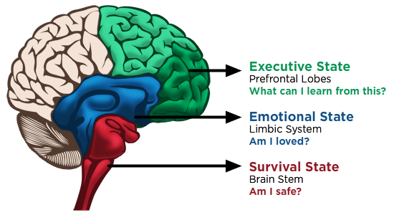

Slide 4
Leaves:. How can I “leave” a legacy of mastering skills and self-regulation.
Problem Solving:
S: Solutions (family meetings)
P: Positive Intent
A: Assertive Boundaries
C: Consequences
E: Executive Skills
Connection
R: Rituals
E: Encouragement
J: Jobs
E: Empathy
C: Choices
T: The Sense of Family
Trunk: How can I strengthen my
relationships to be strong as a tree trunk?
Safety
N: Noticing
A: Assertive Commands
R: Routines / Pictures
C: Composure
S: Safe Place / Safe Keeper
Roots: How can I “root” a sense of safety for myself and others?

Slide 5
The biggest threat to a child's safety is an out of control adult.
We must teach self-regulation and self-care to prevent cycles of abuse.
www.consciousdiscipline.com

