Slide 1
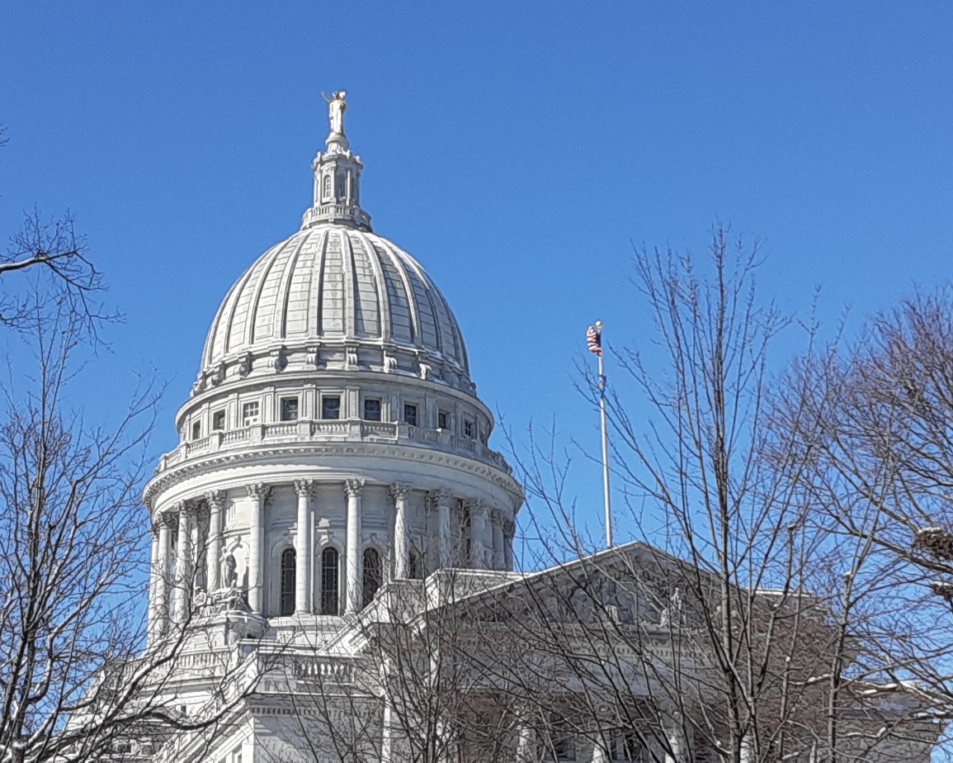
The 2020 Local Redistricting Project
WISE-LR Software & Pilot
Legislative Technology Services Bureau
Ryan Squires GIS Manager

Slide 2
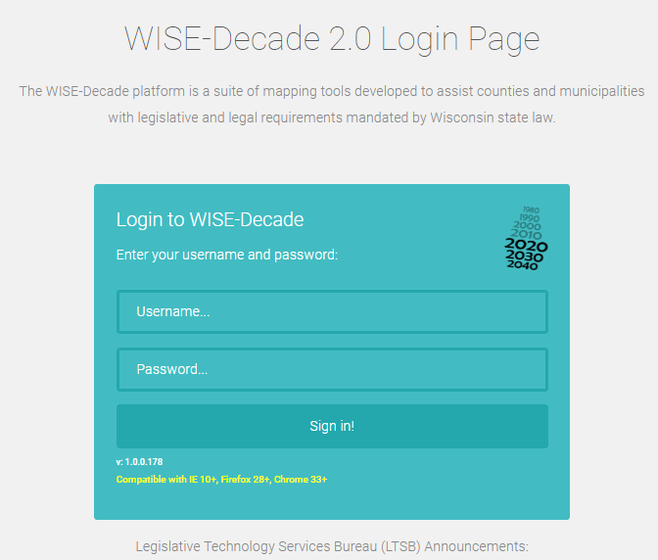
Logging into WISE-LR
Username for every user is your county name
e.g. “Dane”, “Iowa”, “Eau_Claire”
Normal WISE-Decade Password
Allows access to entire WISE-Decade platform
Sent to County Clerk, LIO, & their designees twice a year for BAS/Ward, Parcel, Foundational layer collections.
WISE-LR Only Password
Only allows access to the WISE-LR system
Send to Municipal users, or any County user outside of the County Clerk and LIO. This is to ensure that only designated county officials may change or submit to unrelated programs.

Slide 3
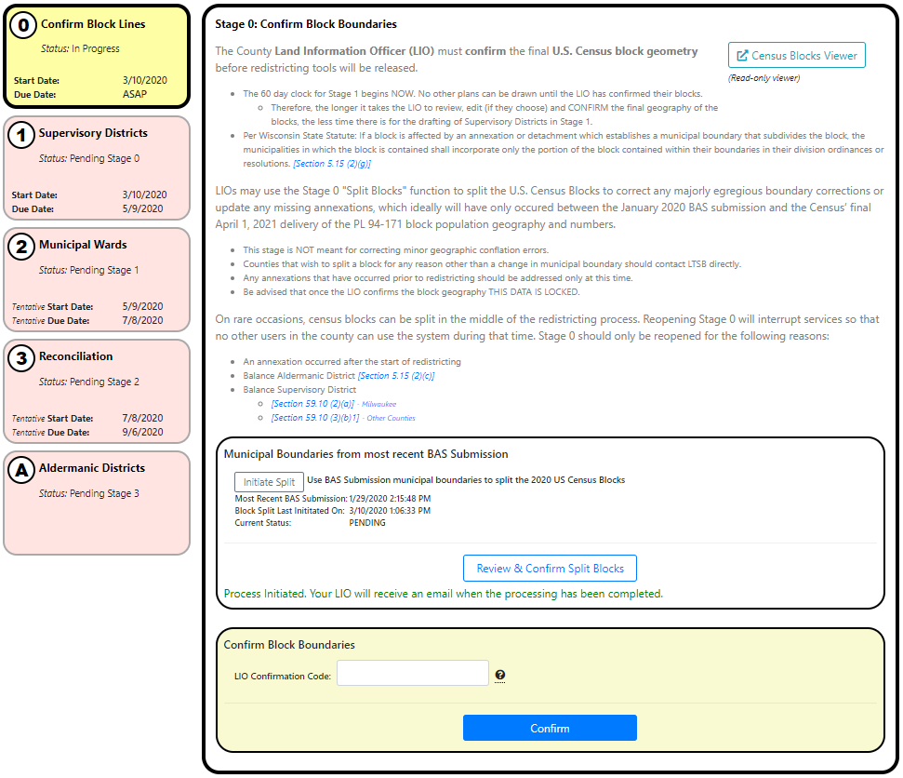
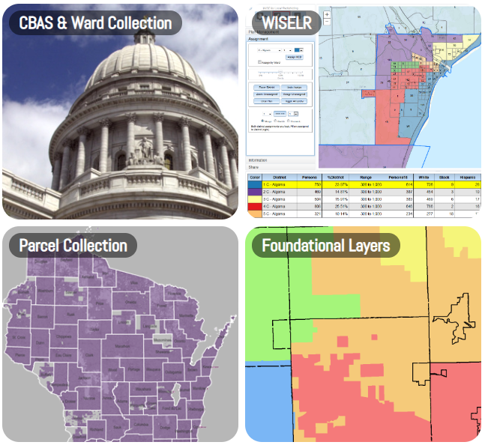
WISE-Decade and WISE-LR URL
https://wisedecade.legis.wisconsin.gov

Slide 4
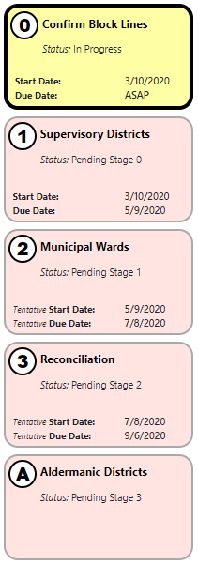
WISE-LR Administrator
Admin console that lists the five potential stages of local redistricting. Includes status of stage and specific deadline for each stage.

Slide 5
Stage 0: Confirm Block Boundaries

Slide 6
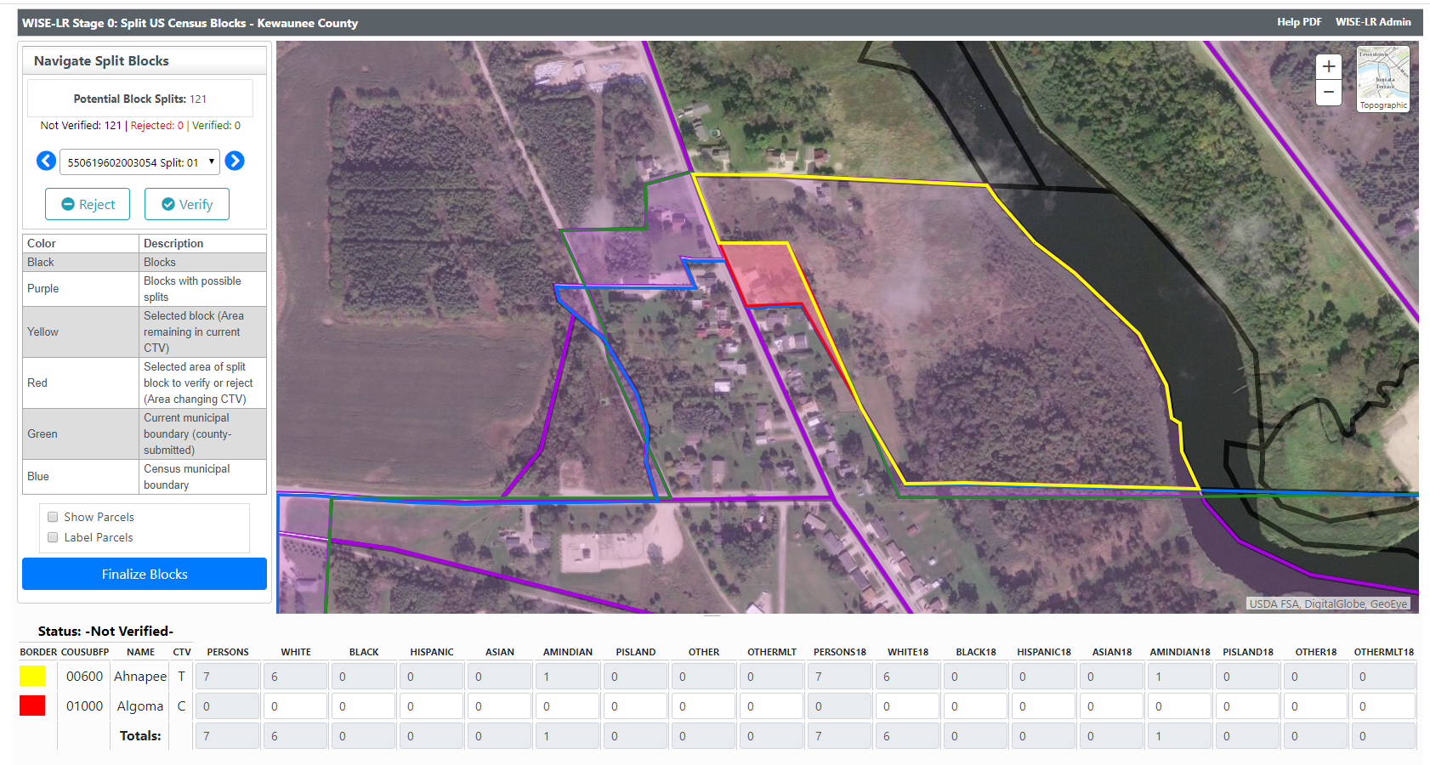
Stage 0: Confirm Block Boundaries

Slide 7
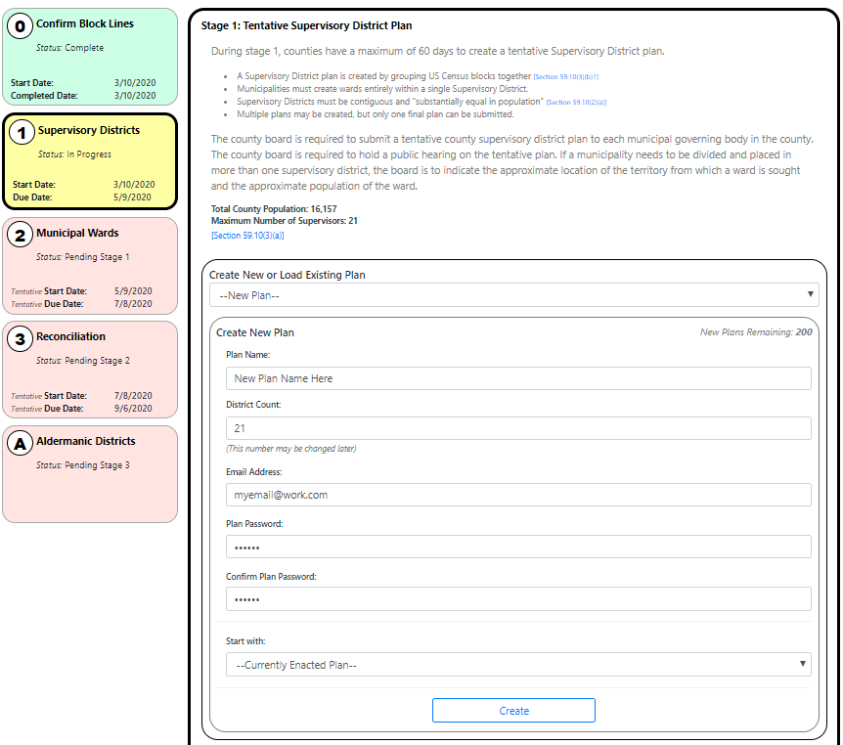
Stage 1: Tentative Supervisory District Plan
During Stage 1, counties have a maximum of 60 days to create a tentative Supervisory District plan.
A Supervisory District plan is created by grouping US Census blocks together.

Slide 8
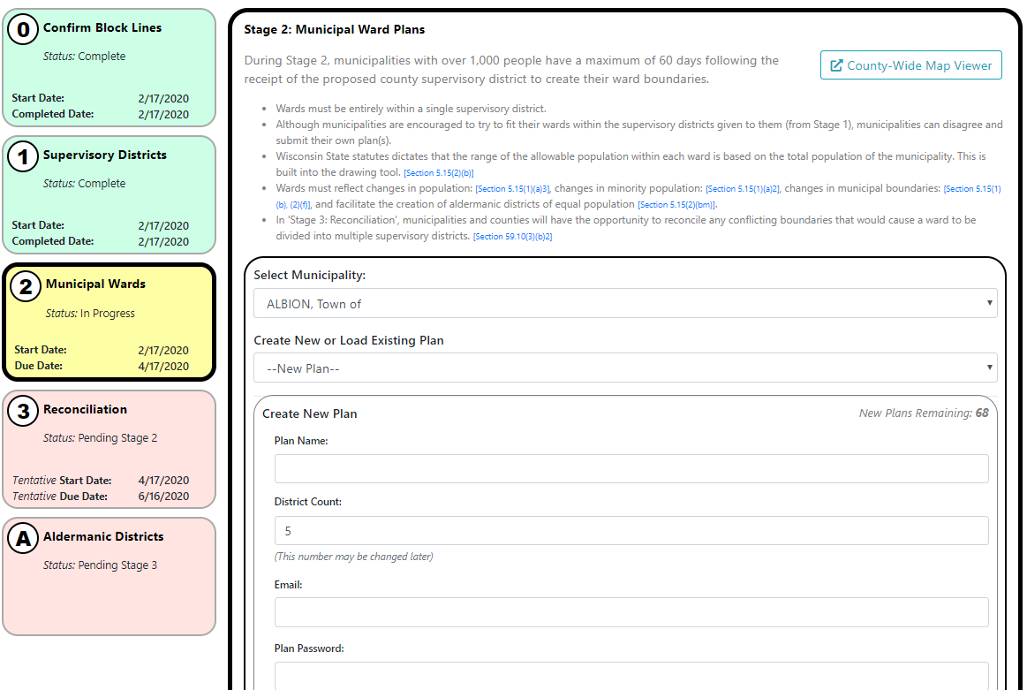
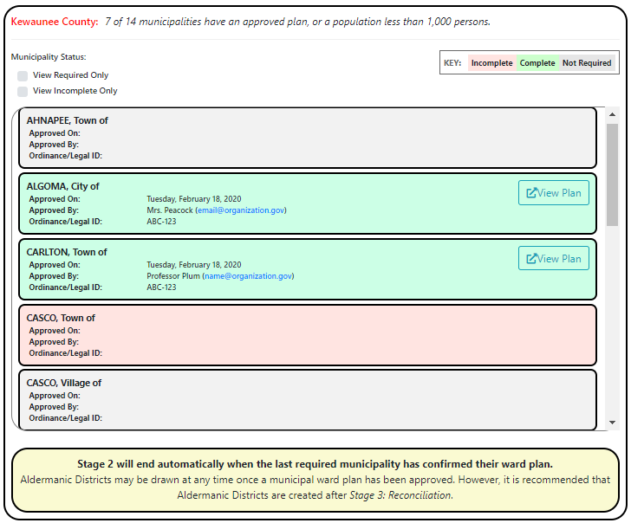
Stage 2: Municipal Ward Plans

Slide 9
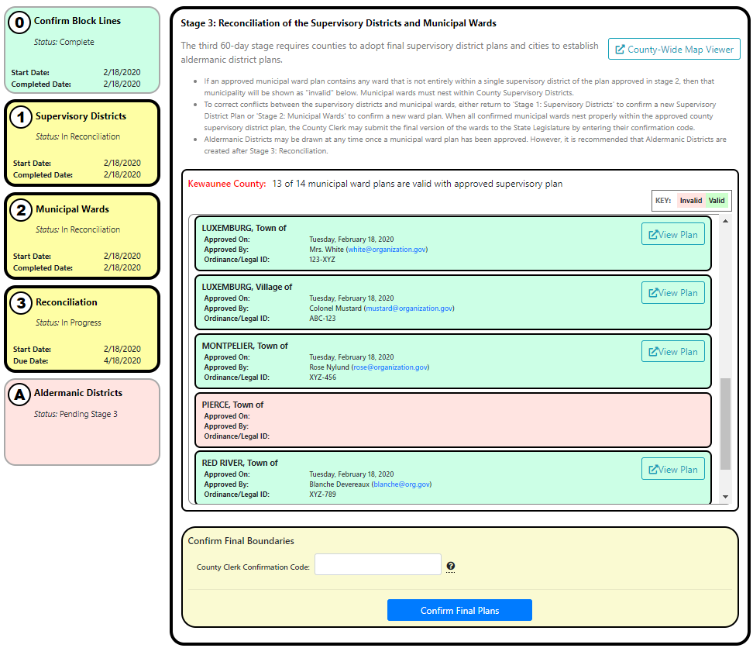
Stage 3: Reconciliation

Slide 10
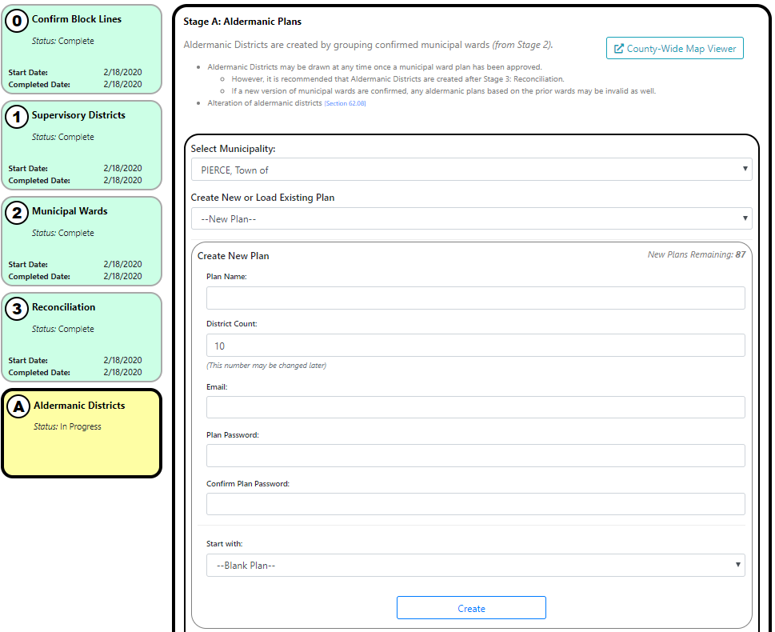
Stage A: Aldermanic Districts

Slide 11
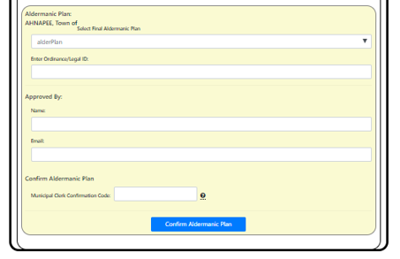
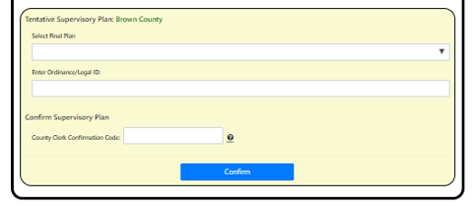
Confirmation Credentials – Confirming a Plan
Provided by LTSB to LIO, County Clerk, and Municipal Clerks and is unique to that single individual.
Used to officially confirm Supervisory, Municipal and Aldermanic Plans once adopted, and to verify US Census Block Geography
Plan’s Ordinance or Legal ID required to confirm
Only the LIO’s code will work to confirm block lines in Stage 0

Slide 12
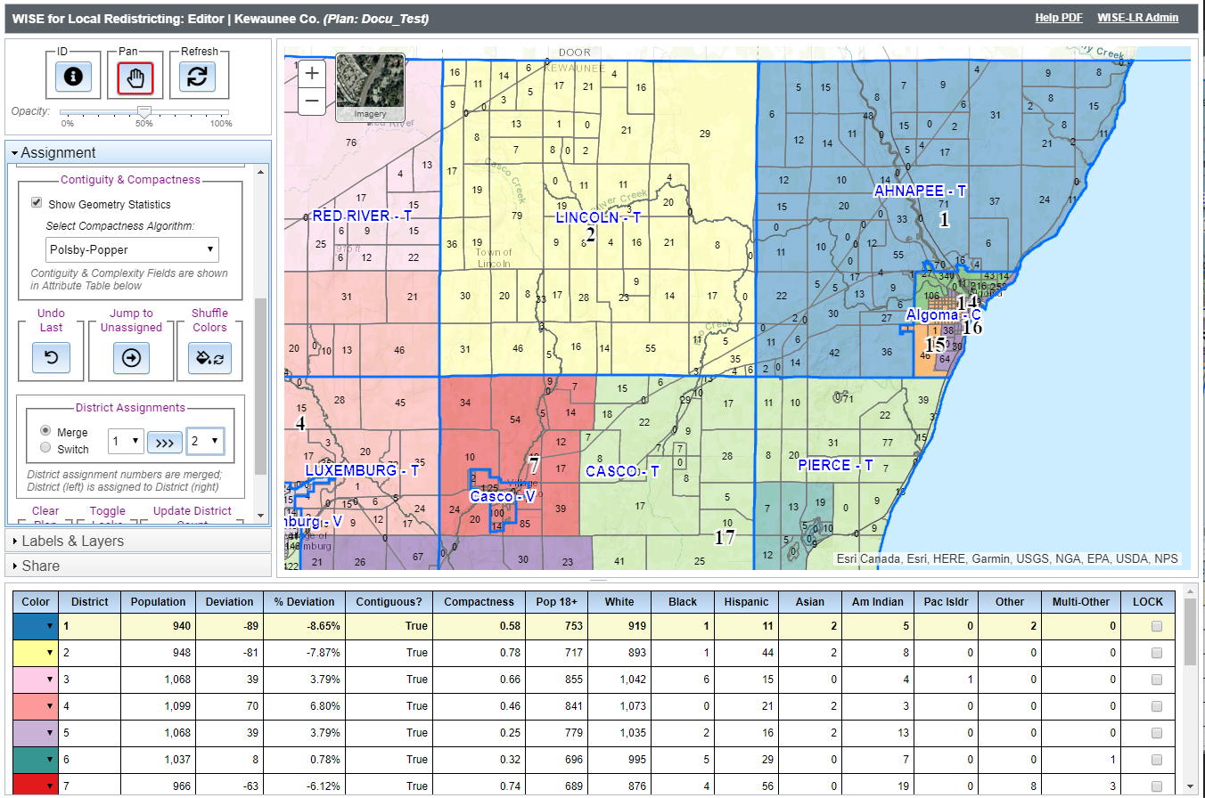
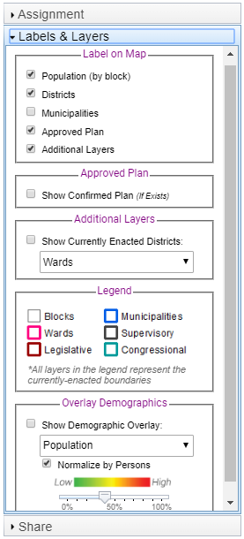
WISE-LR Editor
WISE-LR Editor – Mapping application where all plans are drawn.

Slide 13
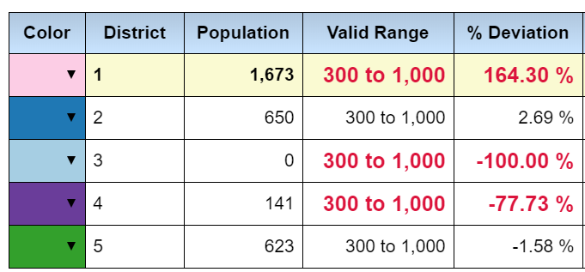
Understanding the Attribute Table
Population (& Demographics)
Aggregate count of block population(s) assigned to a district.
Valid Range (Ward Plans)
Statutorily described range that the ward population must fall within.
Deviation from Ideal (Supervisory Plans)
The ideal population of a Supervisory District is the total population of the county divided by the number of districts. This field will show the count deviation from that ideal population.
% Deviation
Indicates how far from the ideal division of the population by the number of districts or wards.

Slide 14
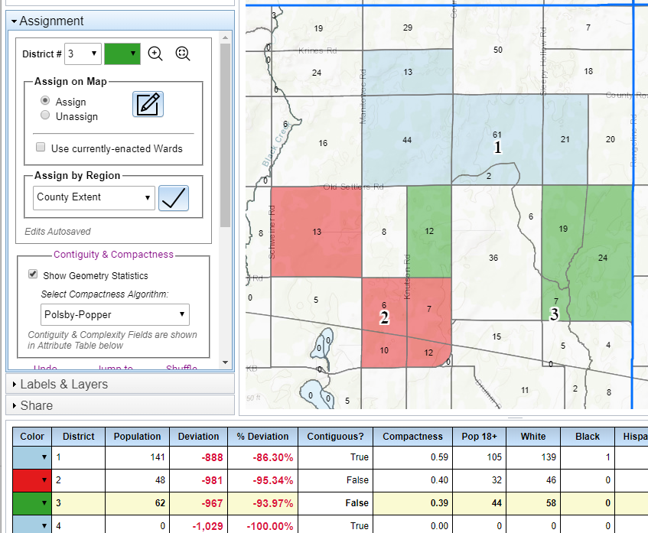
Geometric Attributes
Contiguity
True or False – All blocks within a district (or ward) share a boundary with (or touch) one another. In other words, the district is a single polygon area when ‘True’ or the district has blocks disconnected from the main district when ‘False’
While legally allowed, municipal islands (or actual islands) assigned to a district within the main municipality may show up as non-contiguous.

Slide 15
Geometric Attributes
Compactness Measurements
A score between 0 and 1
1 is most compact
Three algorithms to select from:
Polsby-Popper
Schwartzberg
Area-Convex Hull Ratio

Slide 16
Compactness Measurements
Polsby-Popper: measures is the ratio of the area (A) of the district to the area of a circle whose circumference is equal to the perimeter (P) of the district.
Circumference Equal to District Perimeter
Graphic Credit: https://fisherzachary.github.io/public/r-output.html

Slide 17
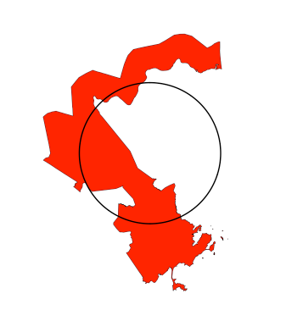
Compactness Measurements
Schwartzberg: ratio of the perimeter (P) of the district to the circumference of a circle whose area is equal to the area of the district (A).
Circle with Area Equivalent to the District
Graphic Credit: https://fisherzachary.github.io/public/r-output.html

Slide 18
Compactness Measurements
Area/Convex Hull: compares the area of the district (A) to the area of the smallest bounding convex polygon (C). The score penalizes for boundary contortions, but grants flexibility as any non-concave polygon is seen as ideal.
Convex Hull
Graphic Credit: https://fisherzachary.github.io/public/r-output.html

Slide 19
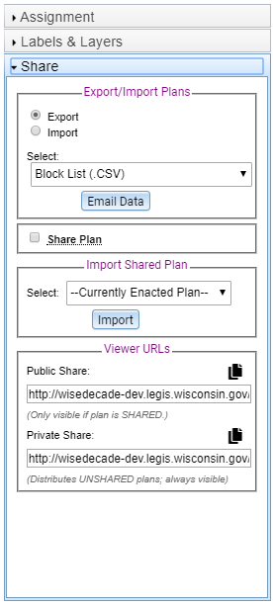
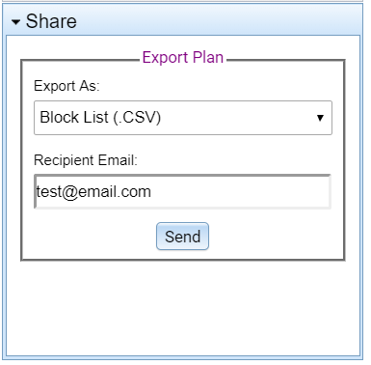
Sharing Plans
WISE-LR Editor
Public Share URL
Only visible within WISE-LR to other county users if plan is SHARED
Private Share URL
Distributes UNSHARED plans; always visible.
Anyone with access to this url will be able to see your plan. Be careful with how this is distributed.
WISE-LR Viewer – What people see if they open a shared url.
Share pane: can send an email to someone with the plan’s data

Slide 20
Pilot Program
Inter-government dress rehearsal of Local Redistricting
Use the opportunity to plan your redistricting for 2021
Reduced time table to allow for busy clerk schedules
Three 14-day stages instead of three 60-day stages
Stage 1: June 1st, 2020
Stage 2: June 15th, 2020
Stage 3: June 29th, 2020

Slide 21
Questions?
Legislative Technology Services Bureau
General LTSB GIS Line
608-283-1830
GIS@legis.Wisconsin.gov
Ryan Squires
608-283-1814
Ryan.Squires@legis.Wisconsin.gov

