Slide 1
HOPE Agenda Heroin, Opiate Prevention & Education
Wisconsin State representative
john Nygren – Assembly district 89

Slide 2
The Growing Epidemic in Wisconsin
Heroin and opiate cases have been spiking in the last few years in Wisconsin. It is now considered an epidemic.
This epidemic affects big cities as well as smaller communities.
Rural areas are also at risk. These areas are less equipped to handle this problem than larger cities like Milwaukee and Madison.
The heroin and opiate epidemic has become a problem that has increased crime statewide and shocked entire communities.

Slide 3
Statistics
A precursor to Heroin is prescription drug abuse. Heroin use in on the rise in Wisconsin; with that increased use comes an increased number of heroin overdoses.
Drug overdoses have doubled since 2004 and surpassed motor vehicle traffic deaths in 2008.
More Wisconsin residents died in 2013 from drug poisoning than from suicide, breast cancer, colon cancer, firearms, influenza, or HIV.
The State Crime Lab has seen a steady increase in opioid cases in the past decade, rising from 170 in 2004 to 640 in 2013, according to the WI Department of Justice.
Nationwide, 28 percent of police agencies reported controlled prescription drugs as the greatest drug threat last year, compared to less than 10 percent in 2009, according to the 2013 National Drug Threat Survey.

Slide 4
Rep. Nygren’s Story

Slide 5
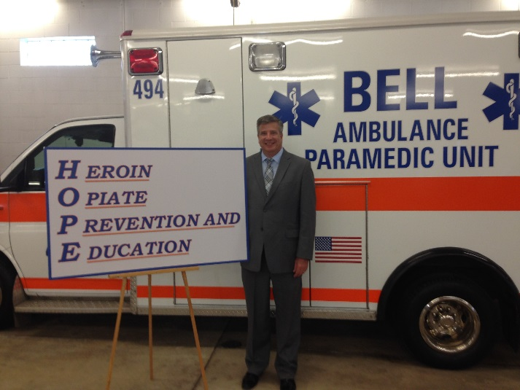
HOPE Agenda: The Introduction
Last year, Rep. Nygren offered a package of seven bills that created the foundation for the HOPE Agenda.
Nygren worked with law enforcement, addiction rehabilitation groups, pharmacists, the legal community, and all levels of state and county government to formulate this comprehensive package.
These seven bills were all passed unanimously by both houses of the legislature and signed into law by Governor Walker in April, 2014.
The seven HOPE Agenda bills were not the silver bullet in solving this epidemic, but they are a solid starting point to build upon for future legislation.

Slide 6
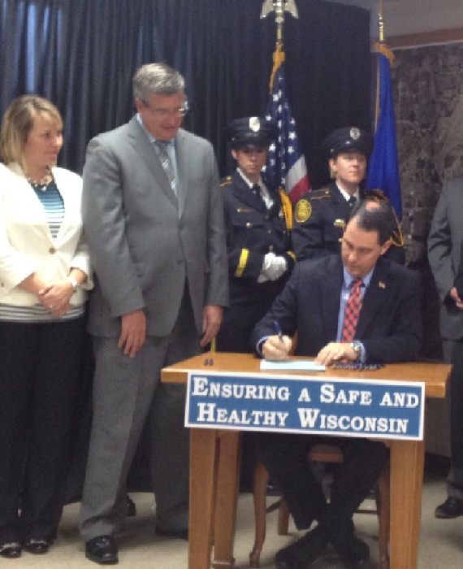
HOPE Agenda: The Foundation
Assembly Bill 445: Requires individuals to show proper identification when picking up schedule II or III narcotic/opiate prescription medication in order to address prescription fraud and diversion.
Assembly Bill 446: Provides all levels of EMTs, first responders, police and fire the ability to be trained to administer Naloxone Narcan, a drug used to counter the effects of opiate overdose, such as a heroin overdose. Any person who administers the drug is immune from civil or criminal liability provided their actions are consistent with Wisconsin’s Good Samaritan law.
Assembly Bill 447: Provides limited immunity from certain criminal prosecutions for a person who seeks assistance from the police or medical professionals for another individual who has overdosed on controlled substances.
Assembly Bill 448: Encourages communities to set up drug disposal programs and regulates these programs so unwanted prescription drugs do not fall into the wrong hands.

Slide 7
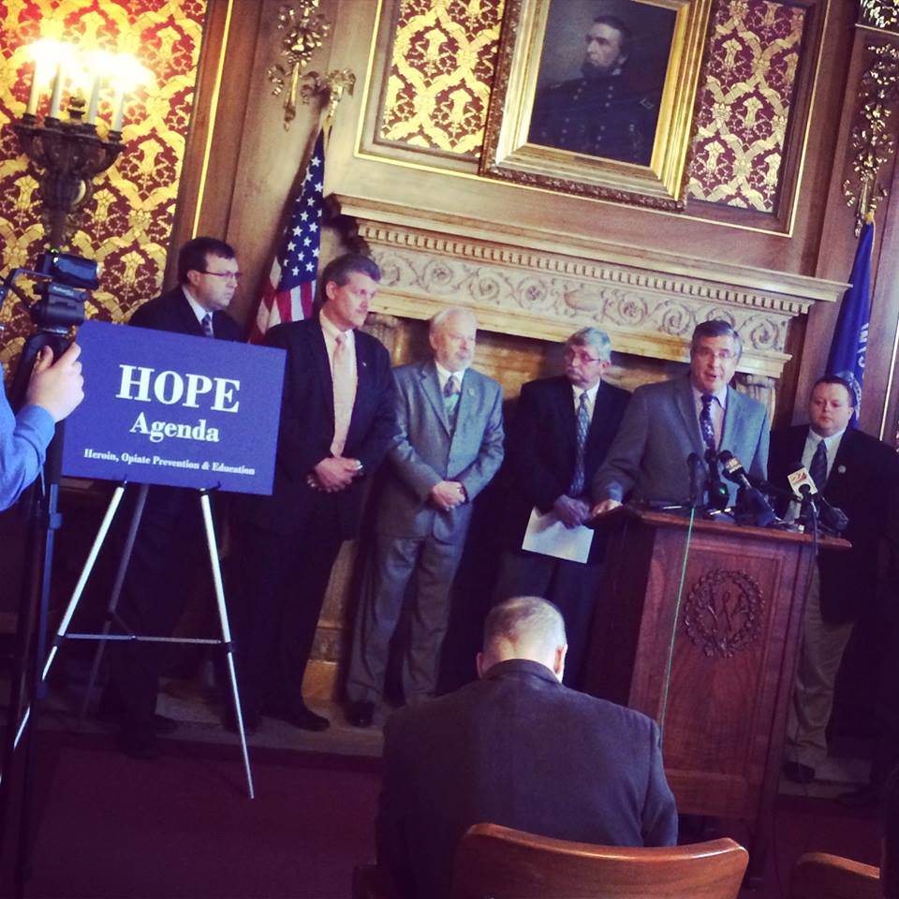
HOPE Agenda: The Foundation
Assembly Bill 668: Expands Treatment Alternatives and Diversion (TAD) programs by increasing funding by $1.5 million annually. Administered by the county, TAD has proven to be an effective and efficient means of combatting drug and alcohol abuse in our state.
Assembly Bill 701: Creates regional pilot programs to address opiate addiction in underserved areas. The treatment programs will assess individuals to determine treatment needs, provide counseling, and medical or abstinence-based treatment. After individuals successfully complete the program, they will be transitioned into county-based or private post-treatment care.
Assembly Bill 702: Creates a system of immediate punishments for individuals who violate their parole or probation parolees based on so-called “swift and certain” laws in other states. The model is based on research that shows that it’s the swiftness and the certainty of the sanction, not the length of the confinement, which has the greatest impact on influencing an offender’s behavior.

Slide 8
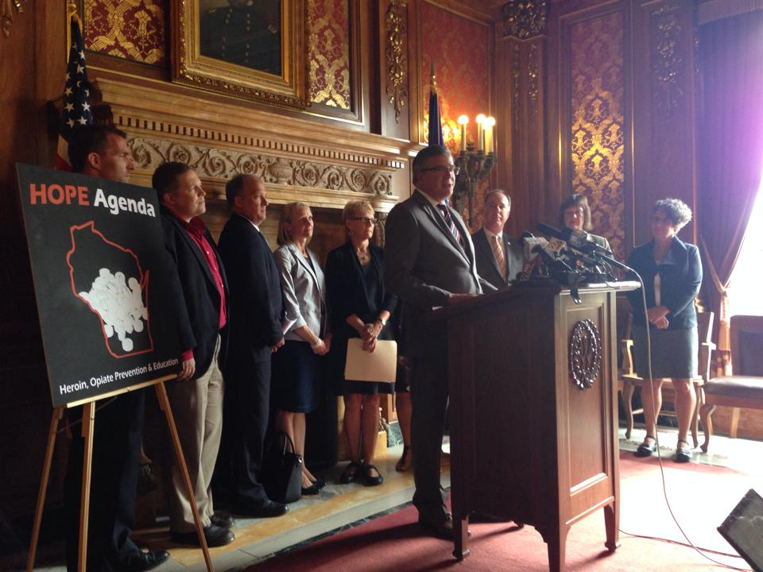
HOPE Agenda: Fall 2015
This session, Rep. Nygren will continue to build upon his HOPE Agenda with four additional bills.
These four bills focus on combating the root of Wisconsin’s heroin epidemic – prescription opiate abuse and addiction.
Many people aren’t aware that, in many cases, heroin addiction begins with addiction to prescription medications. Whether these medications are obtained legally or not, it’s important to curtail the illegal use of these dangerous substances.

Slide 9
Prescription Drug Monitoring Program (PDMP)Legislation
Proposal 1: Change the requirement for those who dispense certain prescription drugs to submit information to the prescription drug monitoring program (PDMP) from 7 days to 24 hours. It will also require a practitioner to review a patient’s record when initially prescribing a monitored prescription drug (for example, a Schedule II drug).
Proposal 2: When law enforcement encounters an inappropriate use or an infraction of the law concerning scheduled drugs, they upload that information into the Prescription Drug Monitoring Program (PDMP) and have the PDMP notify the physician. There are exceptions for on-going investigations.

Slide 10
Pain Clinic Legislation
Proposal 3: Give the Department of Health Services (DHS) oversight over the operation of pain management clinics across the state. The department’s oversight would not be regulatory, but would be a way of providing safeguards so “pill mills” don’t pop up in our state.
Proposal 4: Methadone is a drug assisted treatment run in methadone clinics around the state. It is not uncommon for a patient to regularly go for treatment at a methadone clinic for 5 to 10 years. These clinics are for-profit and receive Medicaid reimbursement. This legislation will have methadone clinics gather data such as staffing ratios, the number of patients receiving behavioral health services with the medication, and average mileage an individual is traveling to come to a clinic. It will then be reported to DHS on an annual basis to give public health and treatment professionals a chance to analyze outcome data.

Slide 11
More Info: Continuing HOPE Agenda Legislation
It’s important to recognize that there are legitimate uses for prescription pain medication. This legislation will not prohibit anyone from receiving the medications that they need.
The two bills regarding the prescription drug monitoring program (PDMP) are registry-based. These bills promote good medical practices, doctor-patient transparency, and an open line of communication between prescribers and dispensers (i.e. doctors and pharmacists).
The PDMP already exists; it is not a new system. It’s a tool to improve patient care and safety and to reduce the abuse and diversion of prescription drugs. It contains information submitted to it by pharmacies and practitioners, including physicians, dentists, advance practice nurse prescribers, and others, about monitored prescription drugs dispensed to patients in Wisconsin.
Only about 14% of the 42,778 prescribers licensed in Wisconsin were registered for PDMP access as of July 31, 2015. Ensuring all prescribers use the program will make it easier to spot issues like overprescribing and help to identify patients who “doctor shop.”

Slide 12
More Info Continued…
The pain management bill and the methadone bill are solely for data collection purposes.
Giving DHS oversight over pain clinics is a preemptive measure that will stop “pill mills” from popping up in Wisconsin.
Other states like Florida have reported issues of prescribers setting up shop in a hotel room for a limited period of time to write prescriptions for paying “customers.” This doesn’t seem to be a major issue in Wisconsin yet, but this bill will stop the problem before it starts.
DHS’s oversight of pain clinics would not be regulatory. The department would simply gather data and observe pain clinics to ensure best practices remain in place.
The goal of the methadone bill is to collect information on the practices of methadone clinics in Wisconsin. With this data, changes can be made in the future about what can be done to improve the practices at these clinics.
More information needs to be collected to determine whether or not addicts benefit from being on methadone for years and years.
Collecting data will help us to build upon past successes of these programs while allowing health experts the ability to identify ways we can improve drug treatment programs.

Slide 13
Dose of Reality
The Wisconsin Department of Justice (DOJ) recently kicked off a new campaign called “Dose of Reality” aimed at curtailing prescription drug abuse and addiction.
This campaign is a statewide effort that offers information, resources, and program materials for those who are interested.
For more information of the campaign, visit www.DoseofRealityWI.gov.

Slide 14
Get Involved
There are many things you can do to get involved and help fight Wisconsin’s heroin and opiate epidemic.
The DOJ facilitates statewide drug take back days sporadically throughout the year. If you have unused or unwanted prescriptions in your medicine cabinet, you can turn them in for safe disposal on drug take back days. More information on dates and locations can be found on DOJ’s Dose of Reality website: www.DoseofRealityWI.gov.
Keep an open line of communication between you and your prescribers. It’s important to stay informed of the risks associated with prescription pain medications.
Many times, over the counter medications will suffice to treat pain after a minor surgery or injury. If you don’t feel as though you need a prescription pain medication to manage your pain, tell your prescriber.

