Slide 1
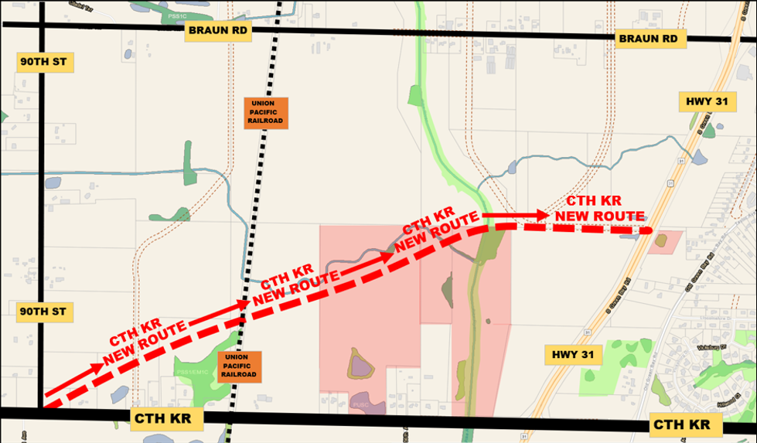
WISCONSIN CTH KR SUGGESTIONS AND IMPROVEMENTS TO CURRENT PROPOSALS OFFERED
SUBMITTED BY: CONCERNED SOMERS PROPERTY OWNERS DETAILS/DRAWINGS: JEANNINE & AL BROKMEIER 5632 1ST PLACE KENOSHA WI 53144

Slide 2
A. MANY QUESTIONS AND CONCERNS HAVE BEEN RAISED REGARDING THE PLAN BEING OFFERED BY THE WISCONSIN DOT UTILIZING THE CURRENT ALIGNMENT OF CTH KR - SPECIFICALLY IN THE AREA EXTENDING FROM 90TH STREET EAST TO STH 31. THESE ISSUES ARE AS FOLLOWS:
WISCONSIN CTH KR
A1 LACK OF ANY ALTERNATE PLANS OFFERED
A2 SAFETY AND ACCESS ISSUES
A3 PROPERTY VALUE PROBLEMS FOR SOME HOMEOWNERS
A4 LACK OF PLANNING FOR FUTURE GROWTH

Slide 3
WISCONSIN CTH KR
A1. LACK OF ANY SUBSTANTIVE ALTERNATIVE PLANS OFFERED
NO ALTERNATE ROUTES FOR CTH KR HAVE BEEN PRESENTED FOR CONSIDERATION AT PUBLIC MEETINGS. WISDOT MAINTAINS THEIR AGENCY WAS ONLY INSTRUCTED TO STUDY THE EXISTING ALIGNMENT OF CTH KR AND THE SCOPE OF THE PROJECT WAS NOT TO EXTEND BEYOND THAT. IF NOT - WHY NOT ? BETTER ALTERNATIVES DO EXIST.
IS THE EXPEDIENCY BEING GIVEN THE CTH KR EXPANSION PROJECT ON THE WESTERN TERMINUS NEAREST FOXCONN, EXCLUDING THE ADDITIONAL TIMELY CONSIDERATION THAT THE EASTERN PORTION OF THE PROJECT DESERVES ?
IT APPEARS THAT THE STUDY ORDERED BY THE VILLAGE OF MT PLEASANT, FOXCONN INITIAL TRAFFIC IMPACT ANALYSIS TADI #2123 DATED DECEMBER 15, 2017, EXPLORES HUNDREDS OF PAGES OF DATA IN DETAIL FOR AREAS ALONG CTH KR WEST OF 90TH STREET. THE STUDY AREA STOPS AT 90TH STREET AND DOES NOT INCLUDE THE REST OF CTH KR EXTENDING EAST TO STH 31. (SEE DRAWING FROM REPORT ON NEXT PAGE). WAS ANOTHER STUDY ORDERED ? AND IF SO, WAS IT MADE AVAILABLE TO THE PUBLIC ?

Slide 4
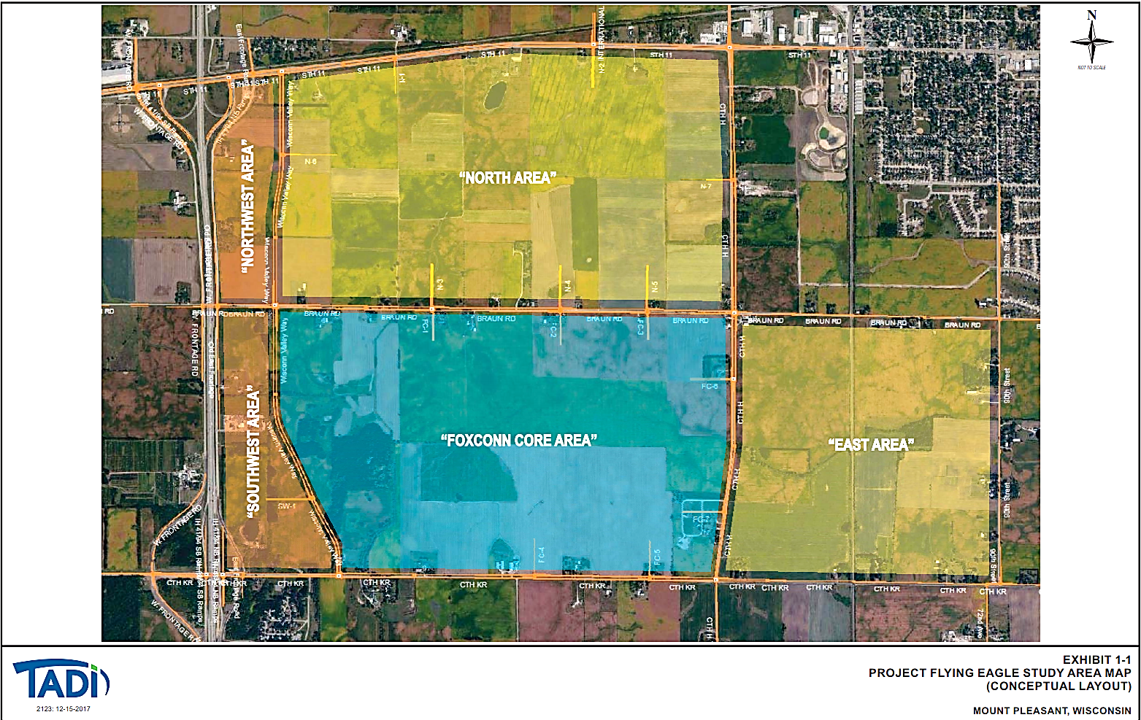
THE STUDY STOPS AT 90TH STREET

Slide 5
WISCONSIN CTH KR
A2. SAFETY AND ACCESS ISSUES
HOMEOWNERS ALONG THE EXISTING ROUTE, AND ALL TRAVELERS ON CTH KR WILL HAVE THEIR SAFETY COMPROMISED BY THE LARGE NUMBER OF DRIVEWAYS WHICH HAVE DIRECT ACCESS ONTO THIS ROADWAY.
CTH KR BETWEEN 90TH STREET AND STH 31 HAS OVER 35 DRIVEWAYS, 1 RAILROAD AND 1 SECONDARY ROAD EXITING DIRECTLY ONTO THIS 45 MPH HIGHWAY. THESE HOMEOWNERS WILL BE COMPETING FOR RIGHT OF WAY ON CTH KR ALONG WITH THE APPROXIMATELY 7000-8000 VEHICALS ALREADY TRAVELING THIS ROUTE EVERY DAY.
IN THE NOT SO DISTANT PAST, CONSIDERATION WAS GIVEN TO THE SAFETY OF CITIZENS OF BOTH RACINE AND KENOSHA COUNTIES WHEN STH 31 WAS REROUTED THROUGH AVAILABLE VACANT AGRICULTURAL PROPERTIES TO AVOID THE EXISTING HIGH CONCENTRATION OF HOMES ALONG THE EXISTING ROUTE. WHY HASN’T THE SAME CONSIDERATION AND THE ALTERNATIVE OF REROUTING THIS SECTION OF CTH KR BEING GIVEN HERE ?

Slide 6
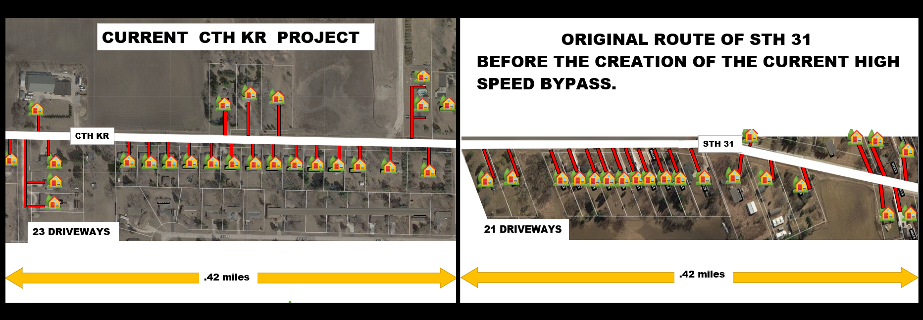
WISCONSIN CTH KR
A2. SAFETY AND ACCESS ISSUES - CONTINUED
BELOW ARE AERIALS OF TWO SECTIONS OF BOTH HIGHWAYS SCALED AND DRAWN TO COMPARE THE SAME LENGTH OF ROADWAY. BOTH WERE EXTRACTED FROM THE SAME MAP. THE ONE ON THE LEFT IS CTH KR AND THE ONE ON THE RIGHT IS OLD STH 31. THE SIMILARITY BETWEEN THE TWO HIGHWAYS IS STRIKING AND CANNOT AND SHOULD NOT BE IGNORED.

Slide 7
WISCONSIN CTH KR
A2. SAFETY AND ACCESS ISSUES - CONTINUED
AERIAL WITH ENHANCEMENTS SHOWING EXISTING CTH KR ROUTE
INDIVIDUAL HOMES AND BUSINESSES ARE HIGHLIGHTED ALONG WITH THEIR RESPECTIVE DRIVEWAYS
THE LINE BELOW IS A HORIZONTAL REPRESENTATION OF THE DISTANCE AND FREQUENCY OF THE DRIVEWAYS AS
WELL AS THE RAILROAD OVERPASS AND THE SECONDARY ROAD AS THEY CROSS CTH KR.
EACH VERTICAL LINE REPRESENTS 1 DRIVEWAY

Slide 8
WISCONSIN CTH KR
A3. DROP IN PROPERTY VALUES FOR SOME HOMEOWNERS
SEVERAL HOMEOWNERS ALONG THE NEW CTH KR ROUTE ARE BEING TOLD THAT THEY HAVE TO ACCEPT HAVING A RAILROAD OVERPASS CONSTRUCTED IN THEIR FRONT YARDS. THEIR FUTURES HOLD AN UNSIGHTLY WALL OF CONCRETE, A DRIVEWAY WITH NO DIRECT ACCESS TO CTH KR, AND DIMINISHED PROPERTY VALUES. WHY AREN’T THESE HOMEOWNERS BEING BOUGHT OUT SO THAT THEY CAN RELOCATE ? IT IS UNACCEPTABLE THAT THESE INDIVIDUALS BE “RAILROADED” INTO ACCEPTING AN “OFFER” SUCH AS THIS.
COUNTY KR – EAST OF UNION PACIFIC RAILROAD
LOOKING NORTH FROM THE DRIVEWAY

Slide 9
WISCONSIN CTH KR
A4. LACK OF PLANNING FOR FUTURE GROWTH OR IMPROVEMENTS
THE POTENTIAL FOR COMMERCIAL AND RESIDENTIAL GROWTH ALONG AND THE AREA AROUND THE ENTIRE ROUTE OF CTH KR IS EXPLOSIVE AND RIPE FOR DEVELOPMENT. HOWEVER, THE CURRENT PROJECT FAILS TO ADDRESS THE FOLLOWING ISSUES THAT WOULD FOSTER THIS EXPANSION.
THE NEED FOR SAFE HIGHER SPEED ACCESS TO THE AREA
THE NEED FOR A FASTER CORRIDOR TO DOWNTOWN RACINE
KEEPING CTH KR ON IT’S EXISTING PROPOSED ALIGNMENT ADDRESSES NEITHER OF THESE ISSUES. THE RESIDENTIAL DEVELOPMENT ON THIS ROADWAY PRECLUDES EITHER THE PHYSICAL OR FINANCIAL PRACTICALITY OF ANY FURTHER DEVELOPMENT ON ITS CURRENT ALIGNMENT. THE ONLY VIABLE OPTION IS RELOCATE NORTH OF THE EXISTING ALIGNMENT.

Slide 10
SUGGESTIONS TO IMPROVE CURRENT PLAN
WISCONSIN CTH KR
1. BYPASS LARGE RESIDENTIAL AREAS WITH DRIVEWAY ACCESS ISSUES
2. CREATE NEW ROADWAYS TO OPEN THE AREA NORTH FOR DEVELOPMENT
3. INVESTIGATE AND CREATE A CORRIDOR TO DOWNTOWN RACINE
4. CREATE A FOXCONN RECREATIONAL/COMMUNITY CENTER ON THE VACANT CASE PLANT LOCATED AT THE LAKEFRONT. THE CORNERSTONE FOR THE REVITALIZATION OF RACINE, THIS WOULD BE THE ULTIMATE DEMONSTRATION OF FOXCONN’S COMMITMENT TO THE COMMUNITY.

Slide 11
3. SINCE THE INTERSECTION OF 90TH STREET AND HWY EA IS ALREADY BEING
REALIGNED, WHY NOT TAKE THIS OPPORTUNITY TO USE THIS AREA AS THE STARTING
POINT TO THE NEW ALTERNATE STH KR ROUTE AND INCORPORATE THIS FEATURE
INTO THE RECONSTRUCTION OF THIS INTERSECTION?

Slide 15
THE COSTS BELOW WOULD NEED TO BE REVISITED BY RACINE AND KENOSHA COUNTIES
HOWEVER, THE POTENTIAL INCREASE IN TAX BASE AND ENHANCED ACCESS TO DOWNTOWN RACINE WHILE REDUCING STRESS ON EXISTING RESIDENTIAL AREAS FAR OUTWEIGH THESE CONCESSIONS.

Slide 16
WISCONSIN CTH KR
IN CONCLUSION
WE HOPE THAT THE POTENTIAL PROBLEMS DISCUSSED IN THIS REPORT ALONG WITH THE PROPOSED SOLUTIONS WILL FOSTER FURTHER DIALOGUE AND CREATE DISCUSSION TOWARDS A MORE CREATIVE RESOLUTION TO WHAT IS OBVIOUSLY A VERY COMPLICATED AND CHALLENGING ISSUE.
WE WOULD WELCOME AND APPRECIATE THE OPPORTUNITY TO PARTICIPATE AND CONTRIBUTE OUR THOUGHTS FURTHER IN THE FINAL SOLUTION WHICH WE KNOW WILL ULTIMATELY BE SUCCESFUL.
SUBMITTED BY: JEANNINE AND ALLEN BROKMEIER
5632 1ST PLACE KENOSHA WI 53144
jbrokmeier@yahoo.com

