Slide 1
Wisconsin State Budget
The
Fine Print

Slide 2
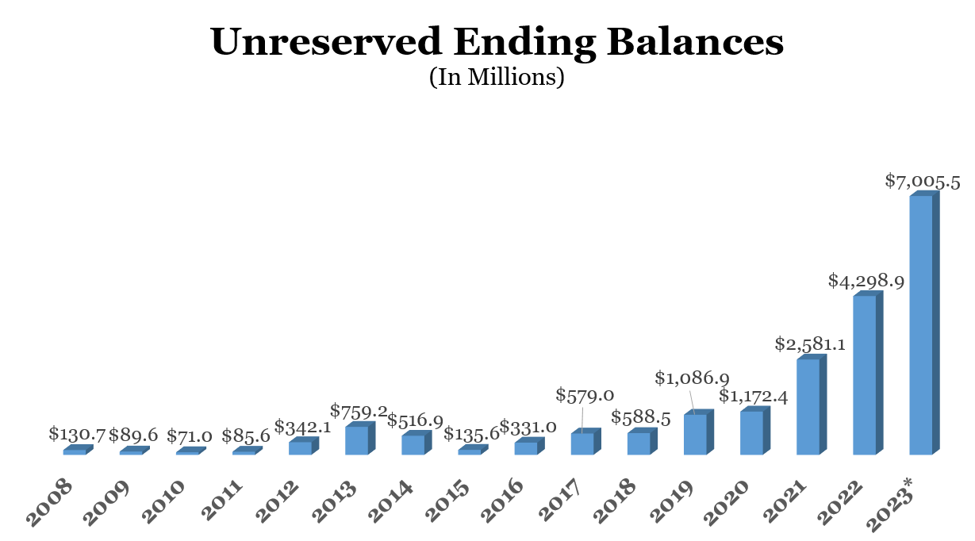
State Budget Background
Wisconsin has a biennial, two-year state budget. The legislative budget process begins in odd years when the Governor releases the executive budget. This typically happens in February.
Wisconsin is not like the federal government. Wisconsin must have a balanced budget. Also, we do not shut down if a budget is not passed and signed by the end of the fiscal year; spending levels from the previous budget are continued.
Thanks to responsible budgeting by Republicans, Wisconsin is in a strong economic position, despite threats of economic uncertainty nationwide.

Slide 3
State Budget: What Happens Now?
Legislature/ Joint Committee on Finance
Executive
Legislature
Executive
Governor reviews budget passed by Legislature and signs it into law in whole or in part or vetoes it in full
State agencies make budget requests
Assembly or Senate receives proposed budget & makes changes. Then sends budget to other house to make changes
Budget received by Joint Committee on Finance
Budget proposed by Governor and sent to Legislature
Committee holds public hearings
With a 2/3rds vote, the Legislature can override any of the Governor’s budget vetoes
Committee makes changes & votes on budget

Slide 4
By the Numbers: Taxes and the Source
State tax dollars are collected through a variety of means – including through the sales and income taxes.
Along with federal money, these dollars make up a bulk of what our state spends each year.
Republicans eliminate all remaining portions of state property taxes, so all remaining property taxes are from local governments.

Slide 5
By the Numbers: Where the Money is Spent
State general purpose dollars are mostly used for education and health care for the poor.
Human relations and resources include low income health care like BadgerCare.
Programs – like state transportation spending – largely come from separate, segregated accounts.

Slide 6
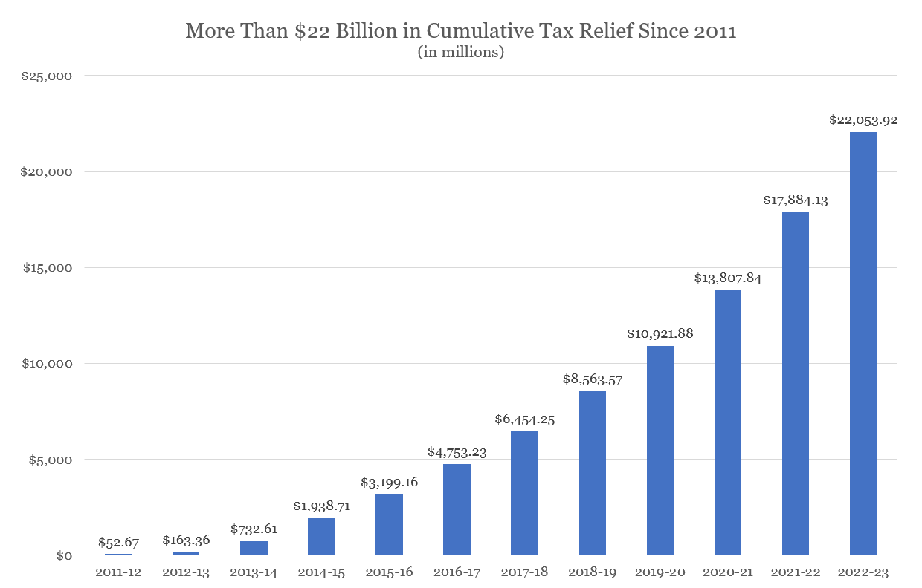
By the Numbers: Taxes Over the Years
Under Republican leadership, we’ve provided major tax cuts
A median-income family is paying over $1,500 less each year in income taxes thanks to Republican tax cuts
Republicans provided over $8.5 billion in property tax relief since 2014
Governor Evers is proposing more than $1.5 billion in tax increases

Slide 7
By the Numbers: Evers’ Spending Spree
Republicans had been leading the state since 2011. Prior to the pandemic, dependence on welfare was decreasing and our unemployment rate was hovering at a historical low.
Gov. Evers has proposed spending much more in this budget than before – reversing the policies that aided our economic growth and turning surpluses into deficits.
*Governor proposed

Slide 8
By the Numbers: Evers’ Spending Spree and Items that Don’t Belong in a Budget
Expands the size of state government by adding more than 800 new employees across agencies
Increases spending by 23%
Repeals Act 10, prevailing wage and other reforms that have saved billions
Extends in-state tuition benefits to undocumented immigrants and gives driver license to illegal immigrants
Expands welfare benefits while eliminating drug testing and work requirement safeguards
Loosens voting requirements and proposes gun control laws
Much, much more…

Slide 9
Budgeting Within our Means
Our budget is projected to have a $7 billion surplus and our state’s rainy day fund is estimated to be nearly $1.7 billion.
There are a number of shared priorities in this budget that we can work together on such as K-12 education and workforce development – but Gov. Evers’ budget proposal relies too heavily on tax increases and out of control spending to be taken seriously.
Evers’ budget would create a $1.4 billion structural deficit going forward!
Economists are warning of economic uncertainty ahead – hiking taxes and expanding government will only take us backward.
Next Steps
Now that Gov. Evers’ budget bill has been introduced, the Legislature will begin our work by reviewing the contents of the budget and holding public hearings around the state.

Slide 10
Thank You for Your Input!
Questions? Feedback?
[Insert Bio Photo Here]
Visit Wisconsin State Rep. Michalski to provide feedback or inquire about specific budget provisions. Or call my office toll-free at: (608)-237-9113
Scan this QR Code to find a copy of Gov. Evers’ budget proposal

