Slide 1
Expanding Access to Mental Health Care Jon A. Lehrmann, MD Charles E. Kubly Professor and Chair, Department of Psychiatry and Behavioral Medicine, Medical College of Wisconsin, ACOS for Mental Health, Milwaukee VAMC

Slide 2
“There is no Health without Mental Health.”
Notes:
This is one of my favorite quotes and I think for our discussion it carries a lot of meaning.

Slide 3
Merriam Webster Definition of Crisis: an unstable or crucial time or state of affairs in which a decisive change is impending; especially one with distinct possibility of a highly undesirable outcome.
We Are In the Midst of a Mental Health Crisis
Notes:
Talk of my two son’s experiences at UW Madison

Slide 4
In the Midst of a MH Crisis- our Environment:
A recent Kaiser study ranked Wisconsin 49 out of 50 states meeting under 21% of the state’s MH needs
The Wisconsin DHS found that 68 out of our 72 counties have inadequate psychiatrist numbers to meet MH needs
49 of our 72 counties do not even have one child psychiatrist
Only 44% of adults with diagnosable mental health problems and less than 20% of children receive needed MH treatment
59% of psychiatrists are 55 or older- (third oldest medical specialty) so the shortage is likely to get worse
Half of all mental health disorders show first signs before age 14, and three quarters begin before age 24 y/o
Most kids have had MH problems for several years before they finally get in or come to see a BH specialist
Notes:
Mention how mental illness and also stigma take someone’s voice away. Talk of poor reimbursement and how hiring of psychiatrist or psychologist affect my department’s bottom line.

Slide 5
In the Midst of a MH Crisis- the Impact:
Suicide rates up 27% in WI since 1990’s
Suicide is second leading cause of death in 15-24 y/o’s
People with severe mental illness more than 10x more likely to be victims of violent crime than general population
Kids frequently wait 6-24 mos to get in to see a child psychiatrist (would we let them wait that long to see a cardiologist? Psychiatric treatment is just as lifesaving as cadiology)
Wisconsin had the 14th highest rate of suicide in youth among all states (age 5-19).
Wisconsin's youth suicide rate has been higher than the national rate for 29 of the last 32 years (1981-2013).
Notes:
Mention how mental illness and also stigma take someone’s voice away. Talk of poor reimbursement and how hiring of psychiatrist or psychologist affect my department’s bottom line.

Slide 6
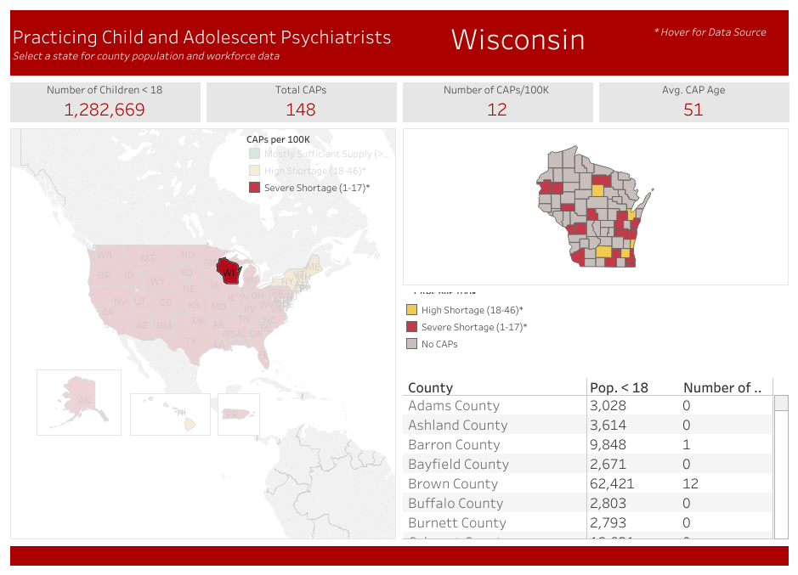
Child Psychiatrists in Wisconsin 2017
Notes:
148 CAP’s in state- some may choose to only work with adults and some have a mix of adult and child patients so it is worse than it looks. Avg age is 51, 49 or 72 counties without a CAP, Even Dane County which is the county with the most CAP’s is rated as a high shortage area

Slide 7
Milliman Study
2017 published study
National study looking at 42 million lives
Shows BH gets reimbursed 20% less than Primary Care, even when using same codes.
Still lack parity!
Psychiatrists who take all patients with all payors often cannot see enough patients to pay for their salary
My Department goes further into debt every time we hire a psychiatrist
Notes:
This is a major issue that clearly affects access. In my department, with our payor mix and in the academic model, if I hire another psychiatrist or psychologist to do clinical work, my department goes further in debt! If I am a Derm dept, and have an access issue- I just hire more dermatolgists…

Slide 8
Primary Care Providers Feeling the Pressure and Weight
With the shortage of psychiatrists and long wait times to get someone in to see a psychiatrist (in some cases up to 2 years), PCP’s are having to take on more MH care whether they want to or not!
Most PCP’s have limited training in MH care

Slide 9
Here is Some Good News:
Psychiatry has become the most competitive field in all of medicine this past year
(However, we need to create more psychiatry residencies)
Notes:
Just 12 years ago, Psychiatry had a difficult time luring US medical Students into it

Slide 10
What is the Solution?
There is no one solution! We must take a multi-faceted approach and collaboration will be key.
Build workforce
Expand Population Health Models statewide
Integrate MH into Primary Care
Improve Reimbursement
Maximize interprofessional team use
Innovate- Comprehensive Consultation Program

Slide 11
Building New Residencies
Challenges: No CMS increases in 22 years, Many hospitals already capped (5 years from start), no psychiatrists to provide supervision, require specialty rotations
Opportunities: VA, Rural Hospitals, need to partner with multiple systems, State grants
Our experience: MCW in partnership with WI, has built new Psychiatry Residencies in Green Bay and Wausau, WI which will increase psychiatrist production by 40%
Exploring rural child psychiatry track
Notes:
Challenge: Balanced Budget Act of 1997, capped hospitals, lack of faculty, RVU focused clinical systems, lack of specialty rotations; Opportunities: VACAA; Bolstering education using tele-education from the mothership, State grants for establishing rural training programs; Our experience- fragile, need ongoing encouragement and trouble shooting

Slide 12
New Pop Health Consult Models Expand Reach of BH Specialists
SCAN ECHO (VA)
CPCP
Periscope Project
Notes:
Specialty care access network, extension for community healthcare outcomes; methods to help a specialist reach more people

Slide 13
Charles E. Kubly CPCP
How it is funded:
Kubly family,
State of Wisconsin has been a valuable and critical partner
How it works: Education, Consultation, and Resource Coordination
Expansion: New 5 year $2M HRSA grant
Future Plans: make expertise available to school based mental health providers
Notes:
I am married to a pediatrician and she was calling me multiple times per week for psychiatry consultations. She struggled to access CAP expertise

Slide 14
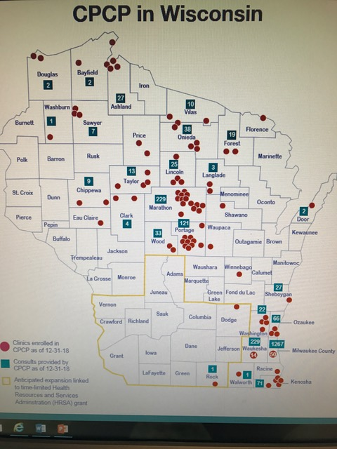
Where CPCP currently serves

Slide 15
CPCP Results
# of providers enrolled:
319 pediatricians
323 Family Medicine
# of consultations:
>2500
# of education episodes provided:
>1200

Slide 16
CPCP Results
Response Time:
95% of time within 15 minutes- in other words, while child is still in provider’s office
Average age of child:
10.75 y/o
Most Common Issues for Consultation:
Anxiety
ADHD
Disruptive behavior
Depression
Notes:
I want to emphasize that this program has made great progress but it is not ideally funded nor ideally staffed. Compare Massachusett’s model and funding.

Slide 17
CPCP Results
Kids Covered so far:
Estimated number of Wisconsin children covered: 277,369*
*This is a huge underestimate since ~200 of our 674 enrolled PCPs do not have data available within the WHIO database
Provider Satisfaction:
Last quarter data for provider satisfaction with consultation was 100% satisfied
Notes:
I want to emphasize that this program has made great progress but it is not ideally funded nor ideally staffed. Compare Massachusett’s model and funding.

Slide 18
Periscope Project
How it is funded:
United Health Foundation
State of Wisconsin
How it works:
Notes:
Perinatal Specialty Consult Psychiatry Extension

Slide 19
Periscope Program Results:
Response time- average is within 8 minutes
Notes:
Perinatal Specialty Consult Psychiatry Extension

Slide 20
July 2017 – December 2018
604 Total Service Inquiries
Tele Consultations
Provider consultations with a subspecialty perinatal psychiatrist
503
Educational Presentations
95 online modules viewed, 22 in person didactic presentations to 837 providers
117
Resource Information
Requested information on resources to support the mental health of their perinatal patient
141
Notes:
As of the end of August : up to 430 total service inquiries and 363 tele-consultations.

Slide 21
Diverse Utilizing Providers

Slide 22
Early Identification and Treatment
Patient Status of Consulting Provider
Top 5 Concerns of Utilizing Providers
7% Preconception or inter-conception
60% Pregnant
Mood Disorder (53%)
Anxiety Disorder (28%)
Substance Use (5%)
28% Postpartum
3% Perinatal Loss
ADHD (5%)
Psychosis (4%)

Slide 23
Periscope is a Bridge to Treatment
‘What would you have done if you had not reached Periscope?’
Refer to mental health
45%
Potential delay in treatment initiation
Research on own
Consult another professional
Notes:
key messaging on bridge to care, earlier initiation of treatment

Slide 24
Utilizing Providers are Satisfied
:
Agreed or strongly agreed they were satisfied with the service they received
Indicate their most recent encounter helped them to more effectively manage their patient's care
Indicate they will incorporate the information they learned in the future care of patients
Based on a three question post-encounter survey with a 69% (346/502) response rate
100%
“Such a quick turn around. I learn something every time I ask for help. My patients love this service, as do I! It assures me I'm providing the best care possible for them!”
“This service was so incredibly helpful. The psychiatrist was calm and explained things so clearly. I really feel like I can more effectively treat my patient and manage her care appropriately because of the guidance I received.”

Slide 25
Success Story
Certified Nurse Midwife (CNM) calls Periscope at 3:29 pm
Case: Patient is 3 months postpartum struggling with depression, complaining of ‘lack of motivation to get out of bed’ and ‘very tired’
Positive PHQ9 on two sperate occasions, treatment initiated not effective, looking for advice on next steps
Triage ends at 3:34 pm
Perinatal Psychiatrist returns call at 3:37 pm
Providers discuss the case and education is provided on treatment recommendations during a 7 minute conversation
15 days later, CNM reports:
“One of the patients I saw a few weeks ago who I called for consult on is doing so much better! Her PHQ-9 score went from a 22 to a 6. I actually saw her smile for the first time in months. It was a wonderful visit. I cannot thank you enough for providing this service to us! I greatly appreciate all the work you do in helping the women of our community.”

Slide 26
Our Vision for a Comprehensive Consultation Program
Use CPCP Infrastructure/Vehicle and add components:
Perinatal Psychiatry
General Psychiatry
Addiction Psychiatry
Geriatric Psychiatry
Veteran Psychiatry
Pain Medicine
*One major barrier for growing this model of care remains a lack of reimbursement
Notes:
No where else in the country do they have such a program. If we put together such a program- Wisconsin could be a national leader.

Slide 27
Integration of MH into Primary care
Our experience
Helps get past stigma barrier
Improves care outcomes
Downstream savings

Slide 28
Increase Reimbursement
Need to increase Medicaid rates as this will allow private psychiatrists to open up to kids on Medicaid
Stop carveouts
Treat MH with true parity

Slide 29
Optimizing Inter-professional Teams
APP’s
Clinical pharmacists
Psychologists
Social Workers
LPC’s
Nurses
Peer Counselors
Each member of healthcare team must work at the “top of their license”.
This is a cost-effective and patient centered approach to improving access by maximizing team work and collaboration. The BH field has often been a leader in inter-professional team care delivery.
Notes:
The more effectively and collaboratively we work from interprofessional teams in a way that allows each provider to practice at the top of their license, the more patients we can serve and provide access to. We need to especially work on the Clinical Pharmacist- the VA has been a leader in utilizing clinical pharmacists as an effective method to expand MH prescribing services

Slide 30
Moving Forward:
I hope you better understand the access challenges to behavioral health care
You have learned some population health approaches toward expanding BH care access that can minimize the effects of stigma
Need to expand CPCP statewide (SB 113/AB 118) and need to find continued funding for Periscope Project
Need to expand psychiatry training including child psychiatry
We must take a multi-faceted approach
Thank you all for serving on this important committee
Questions?
Notes:
Just to review, potential solutions for improving access include: Developing and growing training programs to expand the pipeline; Utilizing and expanding your inter-professional teams in care delivery and utilizing your providers at the top of their license is another important strategy, and fully utilizing clinical pharmacists may be another helpful solution; implementing pop- health consult models like our child psychiatry consult program and our perinatal program helps PCP’s deliver more informed care at the front line when the psychiatry specialists are not available, and integrating BH care into PC is another cost effective approach that helps avoid the stigma barrier, but also allows you to better utilize the psychiatry limited resource to care for the more severe cases. Finally, we have a unique opportunity with the economics of BH care to collaborate across organizations and to partner to provide better access to BH care. I think if we continue to move forward with these solutions, our future is not so bleak and the people we serve can and will have the necessary mental health to be truly healthy.

