Slide 1
The Road to Recovery
Lisa Myhre, BSN, RN
Emily Flannery, BSN, RN
Kayla Jones, MSN, RN
Inpatient Behavioral Health

Slide 2
Objectives
Review the care path a patient follows when one presents to the hospital after a suicide attempt or mental health crisis.
Describe the care team members involved in the care of a patient seeking mental health crisis stabilization.
Examine the care provided in Inpatient Behavioral Health.
Discuss steps taken at time of discharge.

Slide 3
Suicidal Patient in Emergency Services (ES)
Patient arrival by ambulance, police, private vehicle
Triage by RN for suicidality
  If actively suicidal 1:1 supervision initiated prior rooming
Physical Assessment to determine room assignment
    Low or no medical needs: Behavioral Health Pod
    Moderate to High: standard or trauma room

Slide 4
Emergency Services:
Behavioral Health Pod
3 camera monitored rooms
Discrete access offers privacy
Safety
  1:1 staff observation
  All belongings stored outside of room
  Patient wears hospital issued clothing
  Screened with metal detector by security
  Access to medical equipment limited by garage door
Notes:
Patient brought in by police or ambulance are brought in through a back hallway to the behavioral health pod to maintain confidentiality

Slide 5
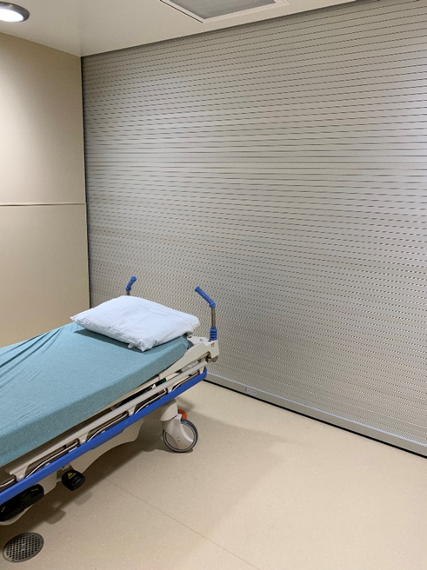
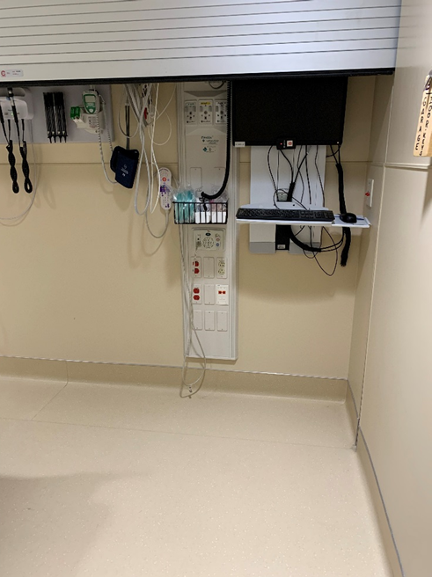
Emergency Services:
Behavioral Health Pod

Slide 6
Emergency Services:
Interdisciplinary Team
Patient assessed by
  RN
  Medical Provider
  Psychiatry
  Social Work
  County Mobile Crisis
  Child Life
  Pharmacy
  Behavioral Response Team (BRT) RN
Notes:
Psychiatric coverage occurs in person most days on Monday through Friday from 0700-1500. Otherwise psychiatrist is consulted via phone.

Slide 7
Potential Outcomes for Voluntary Patients
Psychiatric Assessment
Discharge to home
Stabilize on medical unit
Inpatient Behavioral Health Admission
Discharge to home
Transfer to IBH
Notes:
Criteria for discharge to home: determined by psychiatrist, no longer actively suicidal, safety plan completed

Slide 8
Potential Outcome for Involuntary Patients
County Mobile Crisis assists with assessment and places Chapter 51 hold (72 hour hold)
Transfer to Inpatient Behavioral Health (IBH)
Collaborate with county to determine necessity of pursuing probable cause
Notes:
If no bed, then need to seek another bed within state lines.

Slide 9
Emergency Services:
Patient Death
Support and resources provided to family
  Chaplain services offered (internal and community)
  Bereavement book
  Patient hand prints
  Assistance with notifying family if needed
  Options for funeral homes/cremation
  Patient viewing room
  Great Rivers 2-1-1
Reported to Wisconsin Department of Health Services (DHS)
Root cause analysis

Slide 10
When GHS IBH is at capacity
Emergency Services Social Worker contacts nearest Inpatient Behavioral Health (IBH) facilities to arrange transfer
Emergency Services may hold patient if Gundersen Health System (GHS) IBH expecting bed openings within reasonable time
Patient transported via secure transport, police or ambulance.

Slide 11
Barriers associated with Transfer
Nearest facility: VA (limited to Veterans only) 40 miles
Next nearest Eau Claire: 90 miles
Nearest child facility(12 and under): Meriter 140 miles
Avoid crossing state lines
Transportation options limited

Slide 12
Discharge to home from Emergency Services
Complete safety plan
Refer to Care Center
Partial Hospitalization Program (PHP)
Follow up with outpatient provider or Primary Care Provider (PCP)
Refer to Behavioral Health Assessment and Referral Team
Same day appointment with therapy
Patient Care Facilitator follow up phone contact.
Notes:
Care Center: a short term stabilization option run through the county. Offers a safe place for patients to stay and staff to assist with medication. Patient’s who do not meet criteria for admission to the hospital; however, who are not stable enough to be at home are often discharge to the Care Center.
PHP: An intensive outpatient option, which allows patients to remain at home, but attend programming and groups throughout the day.
Assessment and Referral Team: is staffed by 4 social workers who review referrals sent to them by the ER, the hospital, and clinic. They will contact the patients and help determine the best fit for behavioral health follow up within our system. They set up behavioral health follow up with therapist, social workers, nurse practitioners, and psychiatrist.
The patient care facilitator is often a behavioral health nurse who follows up with the patients.

Slide 13
Stabilization on Medical Unit
Why: significant injury from wound, overdose, etc.
Critical Care Unit or Medical Specialties Unit
Columbia-Suicide Severity Rating Scale (CSSRS)
  1:1 observation for all high risk patients
Safe room set-up
Behavioral Response Team RN (BRT RN) and psychiatry follow daily
Notes:
Safe Room Set Up:
Decreasing the patient’s access to ligature risks.
A ligature risk is defined as anything which could be used to attach a cord, rope, or other material for the purpose of hanging or strangulation.
Examples of ligature risks on a medical unit could be shower rails ,bedframes, IV tubing, oxygen tubing, window and door frames, door handles, blood pressure cuffs, etc
To ensure safe room set up we remove unnecessary equipment, secure patient belonging, store patient’s home medication in the pharmacy, and have them use plastic silverware for their meals

Slide 14
Behavioral Response Team (BRT RN)
Hours: 7am-7pm, 7 days a week
Staffed by: Inpatient Behavioral Health RNs
Purpose: support patients and staff in managing behavioral health needs in the medical setting
    Suicidal ideation and/or attempt
    Altered mental status
    Agitation/aggressive behaviors
    Emotional Support
Notes:
Proactive: These staff members provide consultation for patient identified as having behavioral concerns or mental health needs in order to improve the quality of care provided and assist bedside caregivers
Reactive: In the event of a behavioral escalation or crisis, a BRT will provide immediate response to the bedside to assure the safety of all patients and staff
Majority of work is proactive in nature. Help avoid or deter behaviors before crisis arise

Slide 15
BRT RN Role for
Patients with Suicidal Ideation
Assessments (C-SSRS) and support
Safety planning if patient to discharge home
Educate bedside staff, patient, and family
Facilitate transfer to IBH
  Admission orientation video
  Review precautions and unit guidelines
  Obtain consents
Notes:
Education provided to patients includes information on diagnosis, medication, and coping skills
Education provided to staff includes management of behaviors, desescalation techniques, restraint education, and trauma informed approach to care
Facilitate transfer to IBH: We are a locked facility, so it is important for the patient to be informed of the treatment plan and environment before coming over (no smoking, electronic devices, certain visiting hours).

Slide 16
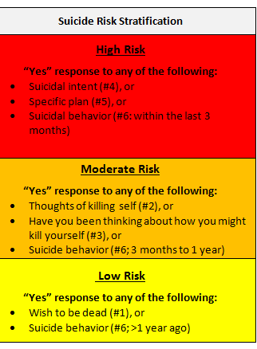
Notes:
No matter what their risk level patients continue to get the same quality level of care; however, the interventions we use look differently for the risk.
High Risk: 1:1 staff, safe room set up, MD contacted, BH consult orders, BH provider must d/c 1:1
Moderate Risk: 1:1 staff, safe room set up, MD contacted, BH consult may be ordered
Low Risk: MD contacted, BH consult may be ordered

Slide 17
Inpatient Behavioral Health
Unit A
  Adult (18 and older)
  14 beds
  Patient Population: Suicidality, Depression, Anxiety, Personality Disorders, OCD, addiction
Unit C
  Adult (18 and older)
  8 beds
  Patient Population: Bipolar, psychosis, self harm behaviors, aggression/agitation, actively suicidal
Adolescent Unit
  Ages 13-18 and still in High School
  8 beds
  Patient Population: all diagnoses
Notes:
2018 data: Average LOS is 6.6 days for adults, 5.1 days for adolescents.
In 2018 we had 1,267 admissions, which was down 41 from the prior year. 219 patients were transferred to IBH from a medical floor.

Slide 18
Inpatient Behavioral Health: Admission
Intake Room
  Private space off unit
  Basic evaluation by CNA
  Personal belongings reviewed for safety
  Patient changes into hospital issued attire until personal item review is complete
Arrival onto Unit
  Tour and unit orientation provided
  Psychosocial and physical assessment completed by RN
  Encourage participation in unit environment
Notes:
Basic evaluation: Vitals, height, and weight. Screened using a metal detector

Slide 19
Inpatient Behavioral Health:
Programming
Interdisciplinary Team
  Patient
  Family
  Support person(s)
  Psychiatrist
  Psychiatric Nurse Practitioner
  Psychologist
  RN
  CNA
  Dietician
Therapist
Social Worker
Occupational Therapy
Recreational Therapy
Peer Specialist
Spiritual Care
Behavioral Health Specialist

Slide 20
Inpatient Behavioral Health: Programming
Therapeutic Offerings
  Dialectical Behavior Therapy
  Acceptance and Commitment Therapy
  Cognitive Behavioral Therapy
  Discharge Planning
  Occupational Therapy
  Recreational Therapy
  Courtyard
Individual Psychotherapy
Spirituality Group
Leisure Assessments
Community Meetings
Pet Therapy
Psychotherapy
Exercise Group
Food for Recovery
Meditative Arts
Recovery Education
Notes:
Programing is scheduled daily and typically runs from 0900 until 2000

Slide 21
Inpatient Behavioral Health: Programming
Daily assessment by Psychiatrist or Psychiatric Nurse Practitioner
  Medications, Electroconvulsive Therapy (ECT), Transmagnetic Stimulation (TMS)
Twice daily assessment by RN
Social Work reviews for community based needs.
Bi-weekly interdisciplinary staffing
Caring Partners Group offered for family/support persons
Notes:
Interdisciplinary Staffing: All the team meets to review the patient’s goals and how they are progressing towards discharge

Slide 22
Inpatient Behavioral Health:
Staff Training
Crisis Prevention Institute (CPI)
Trauma Informed Care (TIC)
Adverse Childhood Experiences (ACEs)
Quarterly staff training
Notes:
Spreading hospital wide
CPI: a specific training that involves verbal de-escalation and at times physical interventions to help staff safety manage and prevent difficult behaviors.
TIC: It is an approach of engaging with patients, which the provider recognizes the presence of trauma symptoms and acknowledges the role that trauma has played in the patient’s lives.
ACES: Is a term used to describe all types of abuse or traumatic experiences that occur to people under the age of 18 which has been linked to a decline in physical health and social functioning. Significant research has been done to support these ideas.
Quarterly staff training: Staff meetings are filled with educational opportunities (e.g. hearing from providers on certain diagnoses)

Slide 23
Inpatient Behavioral Health: Discharge
Destination
Family meeting
Safety Plans
Follow up appointments
  Within 7 days: mental health clinician
  Within 30 days: psychiatric prescriber
Discharge RN follow up phone call
Aftercare Group
Notes:
Discharge destination is usually home, while some patients might go to residential treatment, group home, or tx to higher level of care.
Follow-up appointments are important, as we know most crucial time is the first week post-discharge
It is a challenge to not only get patients scheduled within this recommended timeframe (because of access), but it is also a challenge to get them to come to their appointments.

Slide 24
Notes:
Safety plans: multidisciplinary, reviewed throughout hospitalization, scanned into chart to be used in future encounters

Slide 25
Questions?
For further questions, please contact:
External Affairs
Gundersen Health System
(608) 775-1400
externalaffairs@gundersenhealth.org
Notes:
Thank you for the opportunity to speak with you today. We are pleased to hear that suicide prevention is a priority in the State of Wisconsin.

Slide 26
Questions

