Slide 1
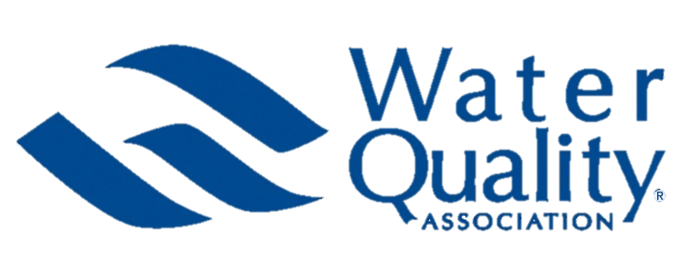
WQA Presentation for the
WI Water Quality Task Force
Overview of WQA
David Loveday
Water Quality Association – Global Government Affairs Director

Slide 2
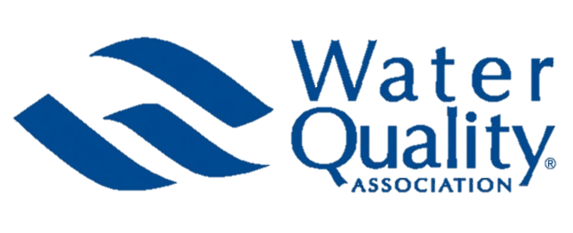
WQA Overview
WQA is an international not-for-profit representing the residential, commercial and industrial water treatment industry since 1974.
David Loveday - Global Government Affairs Director
Eric Yeggy - Technical Affairs Director
WQAW is a separate organization representing similar interests at the state level. They are not a direct affiliate or “chapter” of WQA. But we do collaborate frequently on areas of common interest.
Notes:
Ken G

Slide 3
WQA Membership
More than 2,500 company members worldwide:
600 manufacturer/ supplier companies
1,700 dealers
200 allied members
Notes:
WQA has 25-hundred company members worldwide
Joining gives you access to vast body of industry info: Consumer Option Surveys, Fact Sheets, WQRF Foundation, training programs
Plus opportunity to interact and network with peers around globe

Slide 4
2019-2020 Goal
Improve member value by focusing on:
Advocacy
Professional and product certification
Dealer education
Consumer awareness
Notes:
GOAL: improve member value through
advocacy
professional and product certification
dealer education
consumer awareness

Slide 5
2019 Proposed Legislation
Total Bills (4/1/2019): 126
70% on Lead or PFAS
Bills on Lead in Drinking Water: 64
On Lead in Schools/Child Care Facilities/Parks: 51
Bills on Unregulated Contaminants: 24
On PFAS: 12

Slide 6
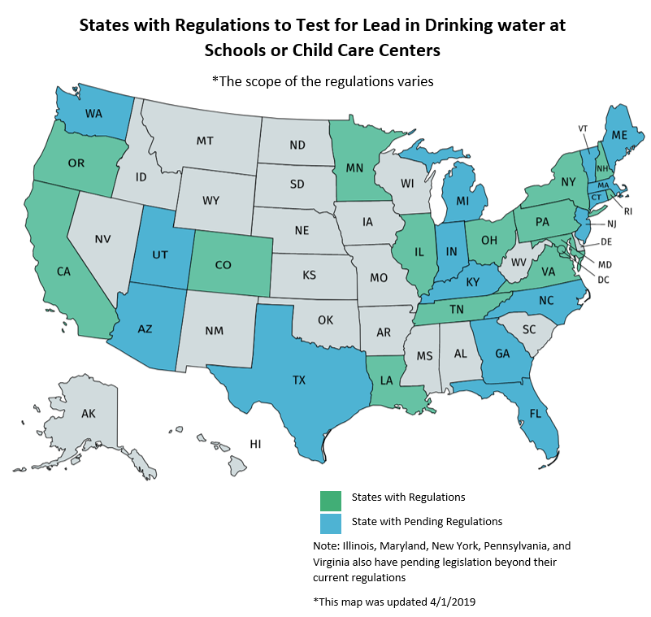

Slide 7
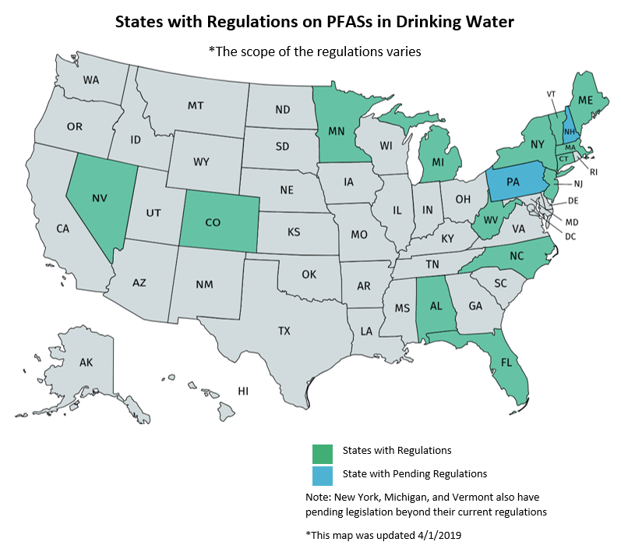

Slide 8
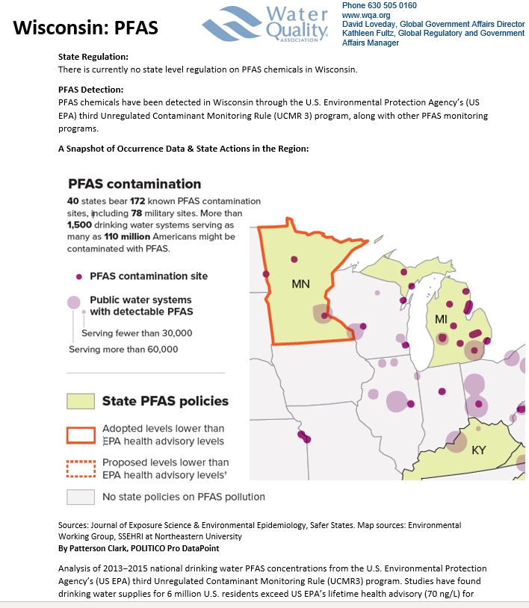
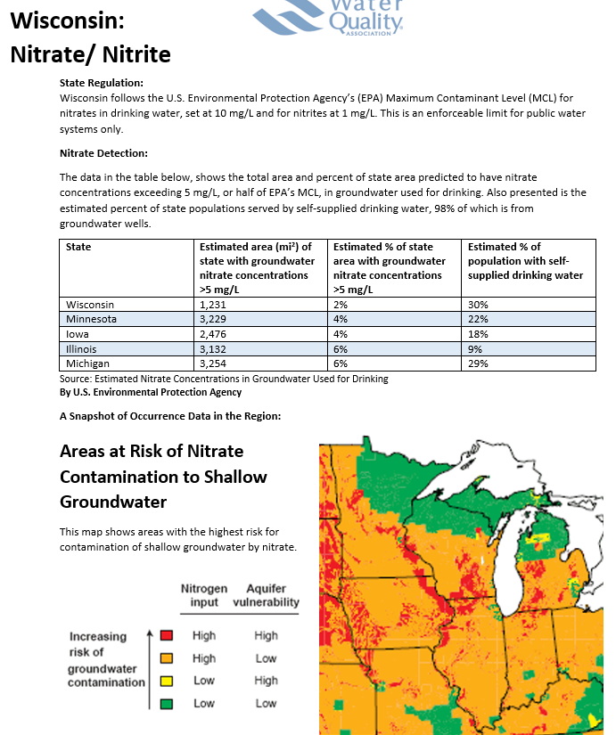
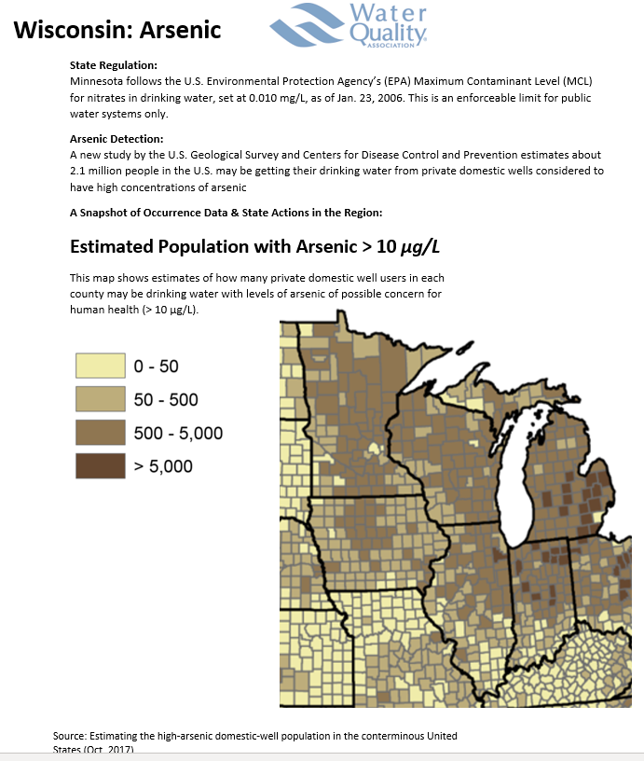

Slide 9
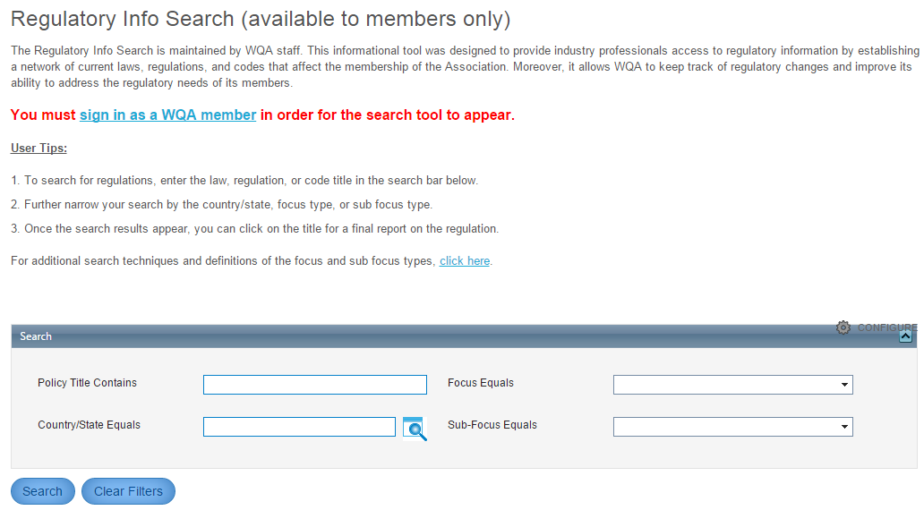
WQA Promotes Regulatory Compliance
Regulatory Info for Members
WQA provides online database of laws, regulations and codes
Over 1,000 rules entered in the database with highlights and hyperlinks to the regulations
Discharge requirements
State amended MCLs
Labeling requirements
Technology acceptance
Standards certification/compliance
State registration
And more…

Slide 10
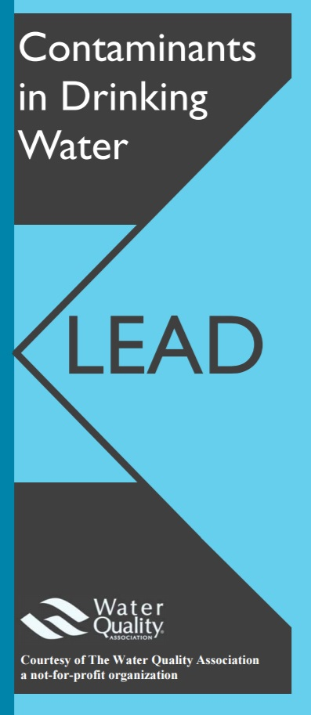
Technical Brochures
Resource guides for policymakers and the general public
Quick facts
Potential health effects
Treatment options

Slide 11
Other Resources for Policy Makers
Also available online through the WQA website at:
https://www.wqa.org/programs-services/government-relations/fact-sheets-other-resources
Arsenic
Per- and Polyfluoroalkyl Substances (PFAS)
Nitrate
Radium

Slide 12
WQA Presentation for the
WI Water Quality Task Force
Final Barrier Treatment Strategy
Eric Yeggy, MWS
Water Quality Association – Technical Affairs Director

Slide 13
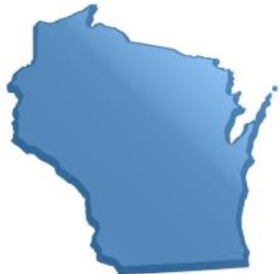
What contaminants are we seeing in Wisconsin?
Contaminants frequently found in source waters used in WI for drinking include…
Arsenic
Nitrate
Pesticides (e.g., Atrazine)
Radiologicals
In addition, lead often finds it way into our drinking water through corrosion of lead service lines, or pipes, fittings, fixtures and solder in the premise plumbing
Emerging contaminants to keep an eye on in WI include Per- and Polyfluoroalkyl Substances (PFAS) and manganese

Slide 14
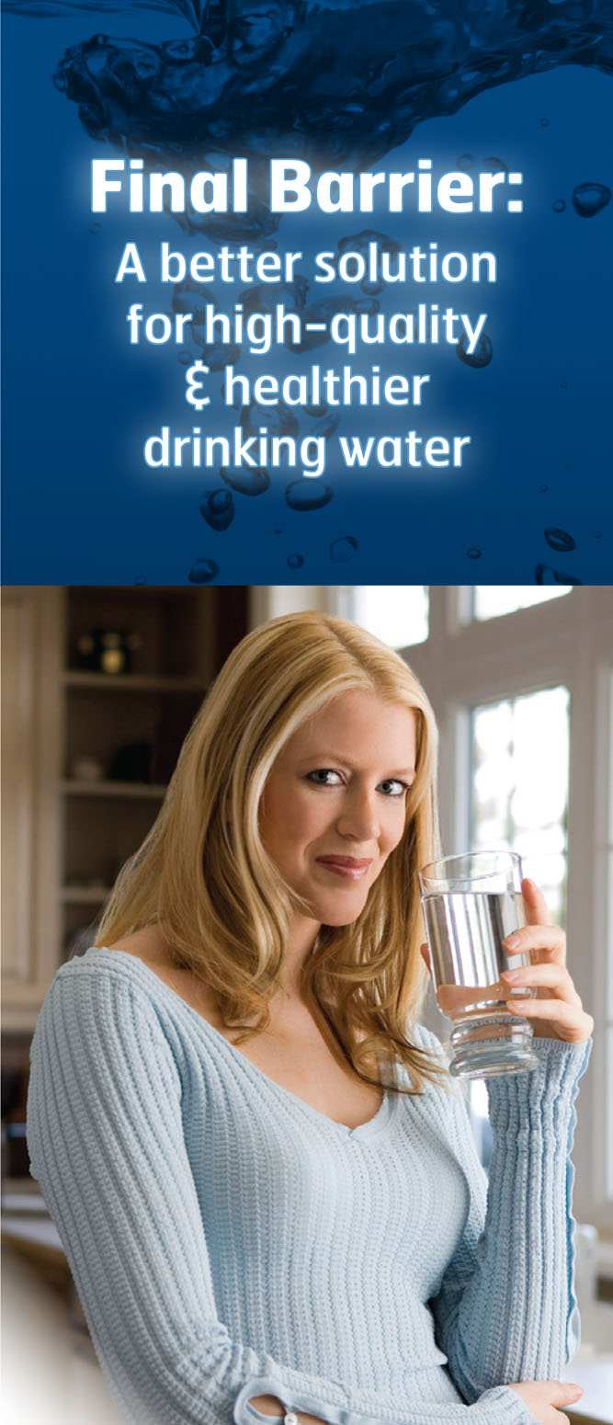
Final Barrier Concept
Using point-of-use or point-of-entry drinking water treatment systems to ensure high quality drinking water is available in a home, office or other building where people gather

Slide 15
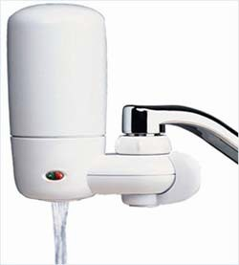
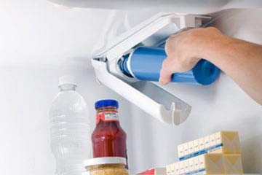
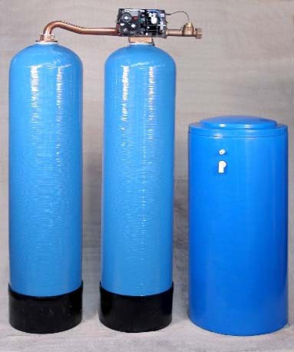
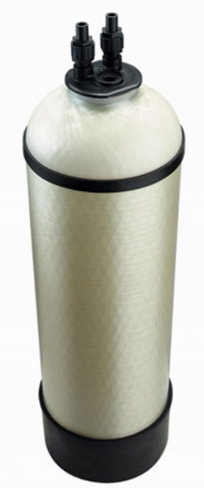
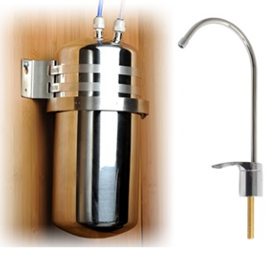
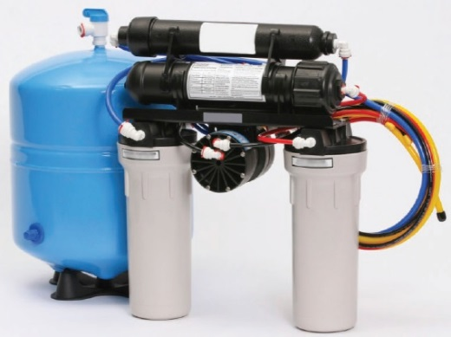
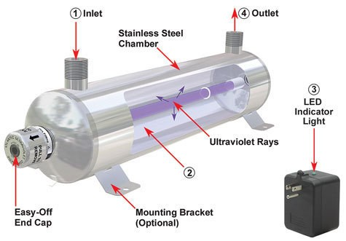
POU/POE Drinking Water Treatment
Point-of-Use Treatment (POU)
Point-of-Entry Treatment (POE)
Faucet Mount filter
Refrigerator filter
Water Softener
Anion Exchange
Under- counter filter
Reverse Osmosis
UV System

Slide 16
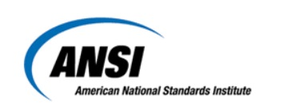
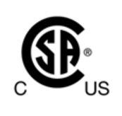
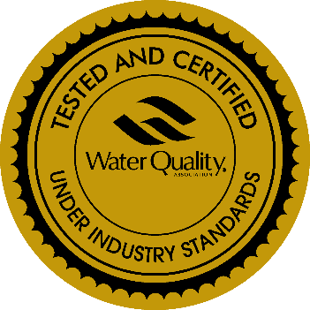
Product Certification ensures independent third-party testing and inspection of the treatment products
Organizations accredited by the American National Standards Institute to provide product certification include:
Water Quality Association (www.wqa.org)
CSA (www.csagroup.org)
IAPMO (www.iapmo.org)
NSF International (www.nsf.org)
Truesdail (www.truesdail.com
UL (www.ul.com)

Slide 17
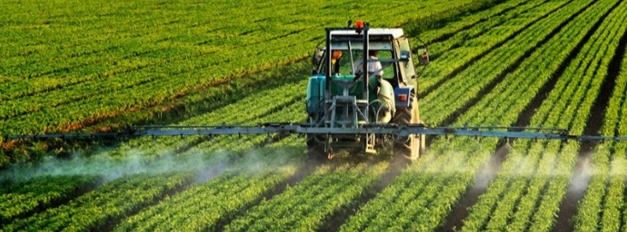
Agricultural Contaminants such as Nitrate & Pesticides
Nitrogen is essential to plant growth
Pesticides help farmers grow more food on less land
When nitrates and pesticides find there way into our drinking water sources, there are serious public health concerns
POU/POE treatment can be used an inexpensive Final Barrier to protect public health when nitrates and pesticides have contaminated a drinking water source

Slide 18
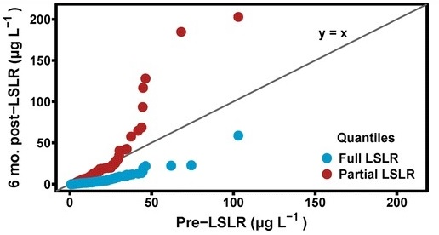
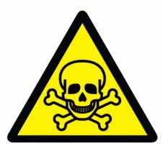
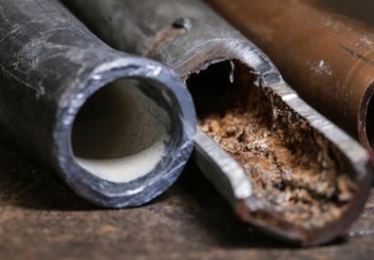
Lead
Trueman et.al. 2016
10 million lead service lines still in use in the U.S.
Source: http://pubs.acs.org/doi/abs/10.1021/acs.est.6b01912?journalCode=esthag
No safe level!
Partial replacement of the lead line does not lower the lead concentration, and often increases it
Lead accumulates in the body over time
Children absorb more lead than adults
Full replacement of the lead line may not get you under the action level

Slide 19
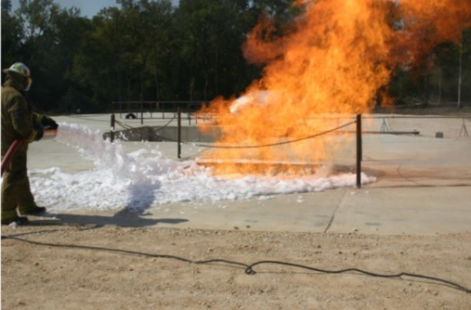
Emerging Contaminants
PFOA found in 94 public water systems in 27 States, serving over 6.5 million people – EWG 2015
Voluntary phase out of PFOA and PFOS in U.S. industry - 2015
Replaced with alternate shorter chain PFCs
Other Emerging Contaminants
Pharmaceuticals & Personal Care Products
Strontium
Manganese
Algae blooms
Microbials
PFAS chemicals are stabile…
Mobile…
Health Impacts?
There are inexpensive POU/POE Treatment solutions for these contaminants

Slide 20
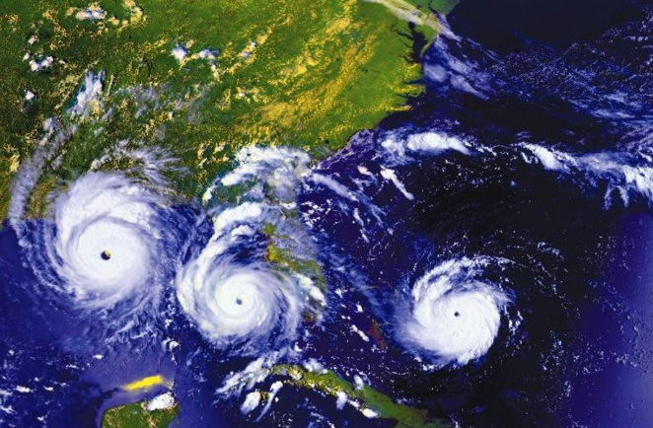
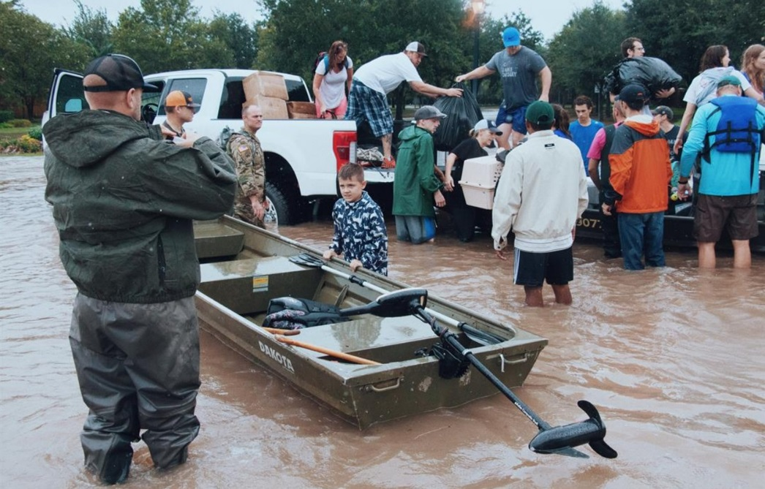
Floods, and other natural disasters cause terrible things…
…and then ordinary people step up to do extraordinary things
WQA can serve as a conduit to reach the industry professionals who can provide safe drinking water during these events

Slide 21
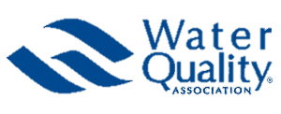
Questions?
Contact info:
Water Quality Association
630-505-0160
David Loveday (dloveday@wqa.org)
Eric Yeggy (eyeggy@wqa.org)

