Slide 1
Water Quality Task Force Recommendations for Clean Water
Bobbi Wilson, Government Relations Associate
April 3rd, 2019
Notes:
My name is Bobbi Wilson and I am here today on behalf of Wisconsin Farmers Union, a member-driven organization that advocates for family farmers and rural communities. I want to talk about how farming impacts water quality in Wisconsin, and how this task force can help farmers do a better job of protecting our water resources.

Slide 2
Farmers and farm organizations have a range of reactions to the growing pressure on agriculture to reduce runoff.
… and, farmers have a lot on their minds outside of water quality.
Notes:
There's a sentiment that farmers need to do more to improve water quality. And let me emphasize that many individual farmers, and Wisconsin Farmers Union as an organization, are very committed to this effort. But if we are trying to get farmers' attention and change their behavior with some of these initiatives, I think we need to understand the issues that are front and center for them -- what they are spending most of their time thinking about.

Slide 3
Wisconsin Net Farm Income in 2010-2018F
$1.7 B
-6%
Good production year, but income depends on prices
Notes:
If you attended this year’s Ag Outlook Forum you have already seen the next few slides. This one shows a decline in net farm income over the last 6 years.

Slide 4
Expenses up 4.2%
(interest, fuel, feed & labor)
Notes:
Meanwhile input costs and farm expenses continue to increase.

Slide 5
Wisconsin Led the Nation in Chapter 12 Bankruptcy Filings for 10/1/17 to 9/30/18
http://www.uscourts.gov/statistics-reports/caseload-statistics-data-tables
Notes:
Wisconsin had the highest number of chapter 12 bankruptcy filings in the country last year.

Slide 6
Government Payments up 18%
Price/Revenue-based payments ARC/PLC -$4.6 B
Market Facilitation Program (MFP): +$4.7 B
Disaster Payments +1.6 B
MFP & Disaster
ARC & PLC
Notes:
Government expenditures are up 18% to help keep farmers afloat during this economic downturn.

Slide 7
Impaired Waters in Wisconsin
Notes:
Hopefully it's obvious enough that farmers are under real financial stress right now. Our surface waters and groundwater are also under stress.

Slide 8
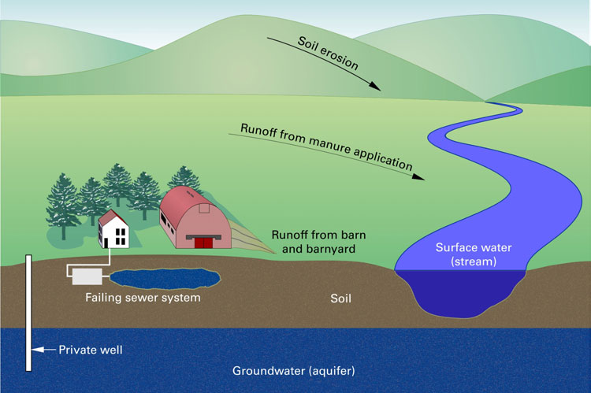
Non-point Source Pollution
Agricultural runoff creates:
Water pollution
Bacteria
Nutrients
Chemicals
Toxic algal blooms
Hypoxia or “dead zones”
Notes:
Non-point source pollution which is coming largely from our farms remains a major, unresolved cause of water pollution in Wisconsin. It causes algal blooms, and hypoxia, or “dead zones” in Green Bay and the Gulf of Mexico.

Slide 9
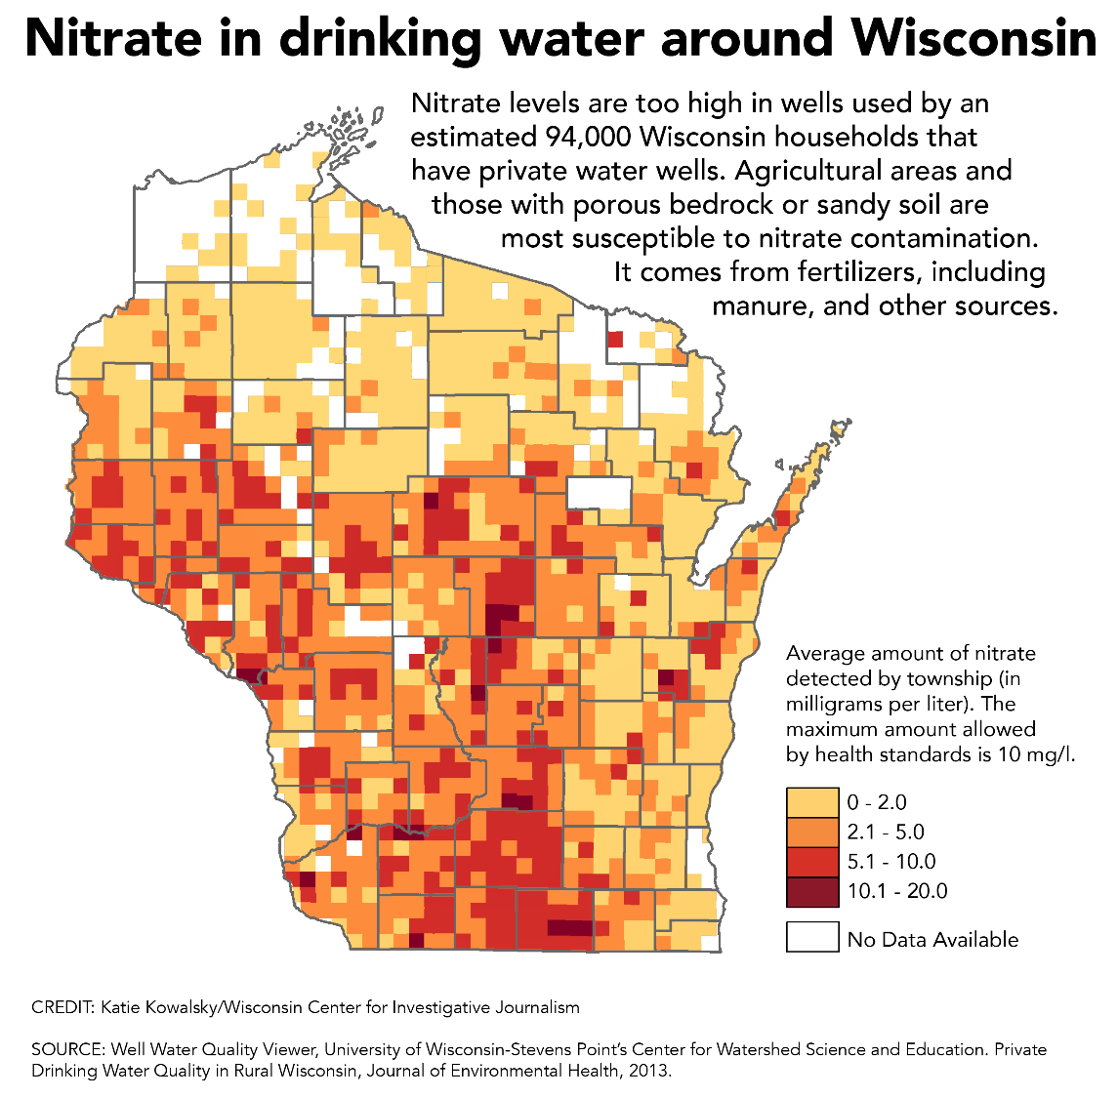
1.8 million Wisconsinites get their drinking water from private wells
94,000 households are drinking from nitrate-contaminated wells
Nitrates pose a public health threat, particularly to pregnant women and infants
Notes:
Nitrate contamination is another growing concern. We have 94,000 households drinking from wells that have unsafe levels of nitrates.

Slide 10
The biggest threat to agriculture and the biggest threat to water quality are one in the same
…that threat is Excess
Notes:
All too often we think of these problems as separate. But what if growing stress on farm incomes and growing stress on water resources isn't just a coincidence? What if they have the same root cause?
The biggest threat to farmers and the biggest threat to water quality are one in the same. That threat is excess. Excess commodities depress prices so that farmers can no longer make a living without off-farm income and government subsidies. And excess nutrients in the water pollute rivers, lakes, and aquifers.
For decades federal policies have told farmers to produce as much as possible as cheaply as possible and hope for a high enough price to squeeze out a profit. We are producing more food than we can consume domestically or profitably export. Over one third is simply thrown away.
In 2017 and 2018, farmers were dumping millions of gallons of milk into their manure pits. What if that milk had never been produced in the first place? Farmers would be better off financially and we would have less strain on our natural resources.
Why do I bring this up? Because I think we’re missing something by talking about symptoms of a problem in isolation. And because there is an expectation that farmers should have to fix this problem on their own. I’m not saying we shouldn’t hold farmers accountable, because we should. But until we address the root of the problem at the federal level we will continue to have polluted water and farmers who feel powerless to do anything about it.
We need to curb overproduction, and base federal farm policy on profitability for farmers and protection of natural resources.
So what can the State do in the meantime? We need to incentivize farmers to adopt better management practices so they don’t lose even more money doing it. And we need to fully fund the agencies tasked with protecting public and environmental health so they can adequately enforce clean water standards.
This is no small task, and we applaud Speaker Vos and this legislature for recognizing the urgency and complexity of this problem and convening this task force to find solutions.

Slide 11
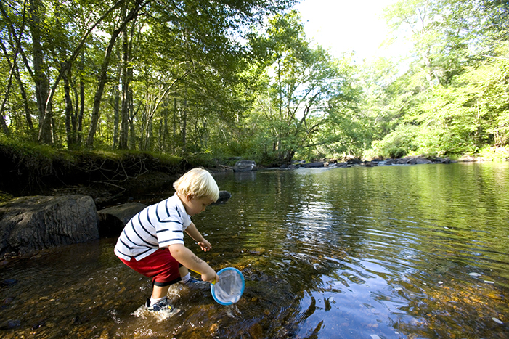
Clean Water Recommendations
Research
Remedies
Prevention:
Incentives
Enforcement
Notes:
Now I will move onto some specific recommendations. They fall into three categories: Research: we need to understand where we are seeing the biggest problems and what the major causes are.
Remedies: we need to offer immediate help to anyone in the state who is currently drinking contaminated water.
And finally we want to see greater emphasis on prevention. It is far easier to prevent pollution from getting into our water than it is to clean it up later.
With regards to prevention, we recommend state incentives for farmers to adopt better management practices, and we also recommend greater enforcement of clean water standards.

Slide 12
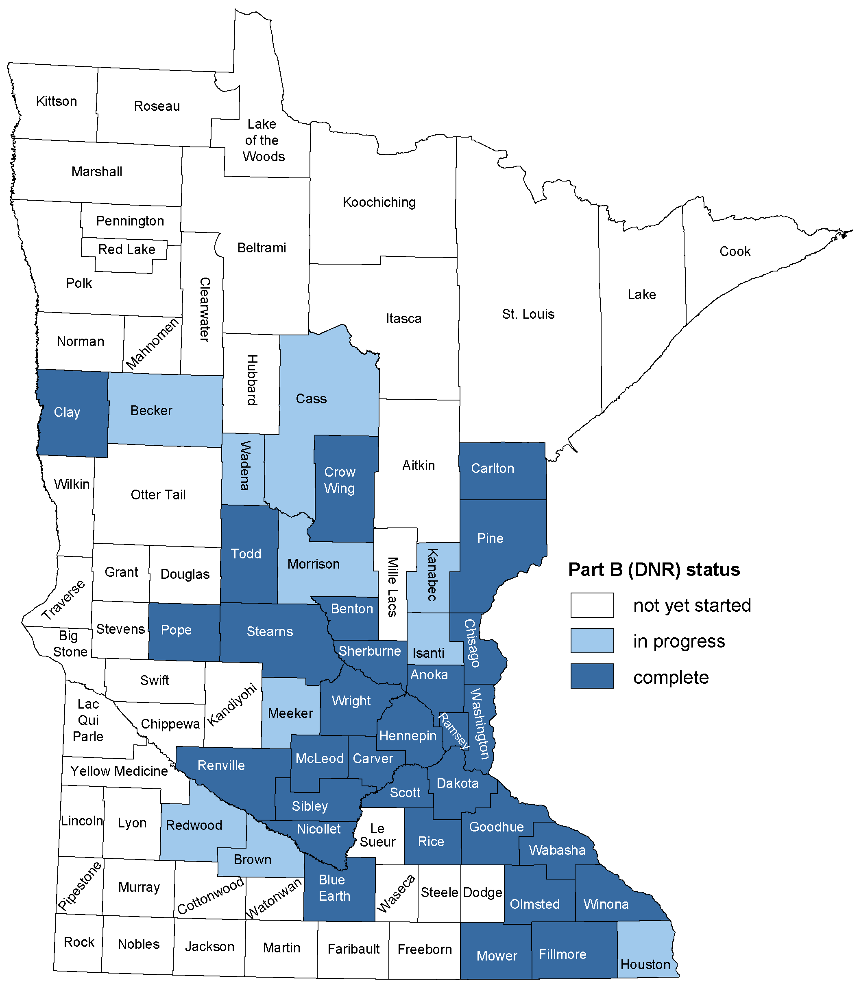
Clean Water Recommendations: Research
County-by-county Groundwater Testing and Mapping
Example: Minnesota County Geologic Atlas
Geology and groundwater resource data
Quality, quantity, and sensitivity to pollution
Coordination between MGS, DNR, and DHS
All county residents can access the same data
Notes:
Starting with research, we need to adopt a program to conduct county-by-county groundwater testing and mapping. Minnesota has a great example called the Minnesota County Geologic Atlas. They routinely collect county-specific data on geology, and groundwater quality, quantity, and sensitivity to pollution. This is a great partnership between state agencies. The Minnesota Geologic Survey maps county geology, their Department of Natural Resources provides groundwater flow patterns, and the Department of Health fills in water quality data. Everyone in the county has access to the same information.
We recommend inviting staff from these departments to come speak to the task force about their program and to answer any questions.

Slide 13
Clean Water Recommendations: Research
Budget Recommendations:
Add 1 FTE ($150,000-$200,000) at the Wisconsin Geological and Natural History Survey to update groundwater maps
Provide $2.5 million/year for county-by-county groundwater mapping

Slide 14
Clean Water Recommendations: Remedies
Improve DNR Well Compensation Grant Program
Increase number of eligible households
Raise income eligibility requirement
Households with nitrate-contaminated wells are eligible regardless of livestock ownership
Prioritize households with highest levels of nitrate contamination
Budget Recommendations:
Increase funding for well testing and remediation from $400,000 to $2 million/year
Notes:
Remedies: we support improving DNR’s well compensation grant program to help families with private well testing and remediation expenses. We support increasing the number of eligible households, and allowing households with nitrate-contaminated wells to be eligible regardless of owning livestock. We also support prioritizing households with the highest level of nitrate contamination. Funding for this program should be increased from $400,000 to $2 million per year.

Slide 15
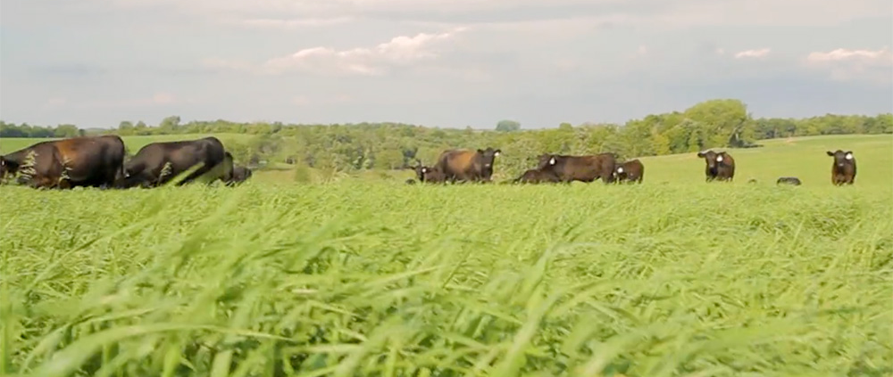
Clean Water Recommendations: Prevention
Managed Grazing:
Farm profitability + water quality protection
Lowers input costs, access to higher-value markets
Reduces soil erosion, runoff, nutrient pollution
Notes:
Now moving onto prevention, which is where we would like to see the task force focus most of its attention.
Our members strongly advocate that managed grazing is the best management practice to control soil erosion and phosphorous pollution.
Managed grazing is also a place where farm profitability and water quality protection intersect. Farmers have the potential to lower input costs and access higher-value markets for grass-based dairy and meat products while reducing soil erosion, runoff, and nutrient pollution.

Slide 16
Clean Water Recommendations: Prevention
Restore Grazing Lands Conservation Initiative (2000-2010)
Prevents 55,179 tons of soil / 441,429 pounds of phosphorus per year from entering Wisconsin waters
Program created 100,000 acres of new well-managed pasture AND over 100,00 acres of improved pasture management
Budget recommendations:
Add 1 FTE at DATCP dedicated to Grazing Education and Coordination
Restore Grazing Land Conservation Initiative competitive grants at $2 million/year
Provide $200,000/year in Grazing Research and Education competitive grants for University and Extension grazing research
Notes:
To help incentivize transitions to pasture-based systems, we recommend restoring the Wisconsin Grazing Lands Conservation Initiative that was in place from 2000 to 2011. The program prevented over 55,000 tons of soil and nearly half a million pounds of phosphorus from entering Wisconsin waters per year. It created 100,000 acres of new well-managed pasture AND over 100,00 acres of improved pasture management
Budget recommendations:
Add 1 FTE at DATCP dedicated to Grazing Education and Coordination
Restore Grazing Land Conservation Initiative competitive grants at $2 million/year
Provide $200,000/year in Grazing Research and Education competitive grants for University and Extension grazing research

Slide 17
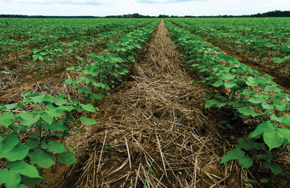
Clean Water Recommendations: Prevention
Cover Crops
Reduce nutrient leaching, soil loss, and runoff
Improve crop productivity and nutrient efficiency
Example: Iowa Crop Insurance Demonstration Project
$5/acre State crop insurance premium discount for cover crops
160,000 acres enrolled
340 insurance agents involved
Notes:
Another highly effective tool for reducing nutrient pollution is cover cropping. Cover crops reduce nutrient leaching, soil loss, and runoff while improving crop productivity and nutrient efficiency.
The state of Iowa recently launched a program to incentivize greater adoption of cover crops. They partnered with the Risk Management Agency to offer a $5 per acre premium discount on crop insurance for planting cover crops. They currently have about 160,000 acres enrolled and 340 insurance agents participating.
The crop insurance incentive was initially proposed as a federal program, but they needed more research to prove actuarial soundness before it could be implemented nationwide. Iowa started their program to help build that research base. There are a few groups in Wisconsin that are working to create another research pilot program which would move this one step closer to being implemented in the next Farm Bill.
I do not have a budget recommendation for this program because it is a new idea that is still being developed and we don’t know what kind of participation rates to expect here. But this would be a great program for this task force to research and move forward with.

Slide 18
Clean Water Recommendations: Prevention
Greater enforcement and higher standards
Restore local control of livestock siting
Allow areas with sensitive groundwater and geologic factors to adopt more stringent livestock siting standards
Increase CAFO monitoring and oversight at DNR
Budget Recommendations:
Add $300,000 per year for CAFO monitoring and oversight at DNR
Notes:
Those are our recommended state incentives for farmers to adopt better water quality practices. At the same time we need to set higher standards where problems persist and make sure those standards are being enforced.
We support restoring local control of livestock siting. Local governments, particularly in areas with sensitive geology and groundwater, should have the authority to set more stringent livestock siting standards based on scientific findings of fact.
We also need to increase CAFO monitoring and oversight. DNR should have the funding, resources, and authority to protect our water resources. We recommend adding $300,000 for CAFO monitoring and oversight to make sure we are holding the farms that pose the greatest risk accountable.

Slide 19
Budget Recommendations
Add 1 FTE ($150,000-$200,000) at the Wisconsin Geological and Natural History Survey to update groundwater maps
Provide $2.5 million/year for county-by-county groundwater mapping
Increase funding for well testing and remediation from $400,000 to $2 million/year
Add 1 FTE at DATCP dedicated to Grazing Education and Coordination
Restore Grazing Land Conservation Initiative competitive grants at $2 million/year
Provide $200,000/year in Grazing Research and Education competitive grants for University and Extension grazing research
Add $300,000 per year for CAFO monitoring and oversight at DNR
Continue funding the Producer-Led Watershed Grant Program at $750,000 per year.
Fully fund County Land and Conservation staffing grants at $12.4 million/year
Notes:
This is a full list of our budget recommendations. I mentioned most of these items throughout the presentation, but I want to add that we strongly advocate for maintaining funding of $750,000 per year for the producer-led watershed grant program and fully funding county land and conservation staffing grants at $12.4 million per year.

Slide 20
Notes:
Finally, going back to my earlier point about excess. We are working very hard on policies that would help farmers profit more by producing less. Our biggest focus right now is in dairy. We are organizing a national tour of “Dairy Together” meetings to promote various federal policy options for supply management. The next meeting is tomorrow at the UW Platteville Pioneer Farm from Noon to 12:30. We invite you to attend.

Slide 21
For more information, please contact:
Kara O’Connor, Government Relations Director
608 514-4541
koconnor@wisconsinfarmersunion.com
or
Bobbi Wilson, Government Relations Associate
608 234-3741
bwilson@wisconsinfarmersunion.com

